Slide 1
CMB, PHY3063

Slide 2
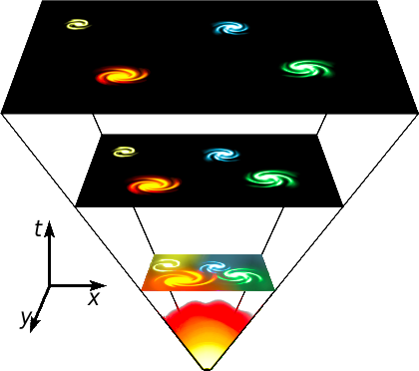
The History of the Universe
Early universe is very dense, particles trapped
Universe expands, density decreases, particles escape into space
Decoupling: particle ceases to interact with other particles
* density of particles too low for interaction to occur
* E of particle too low for interactions
http://en.wikipedia.org/wiki/File:Universe_expansion2.png

Slide 3
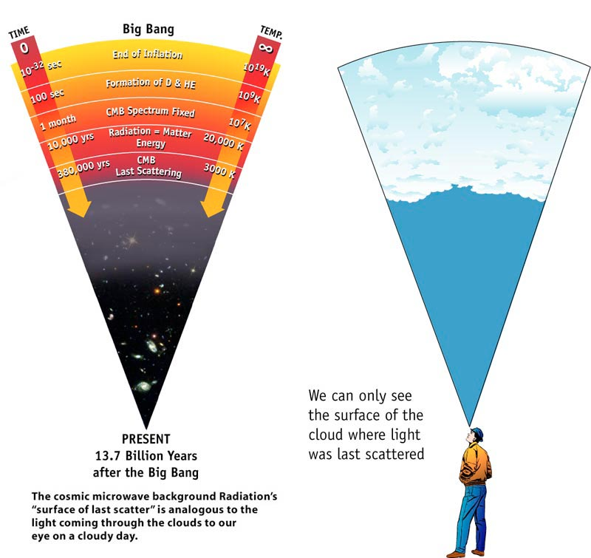
CMB: Decoupling of the Photons
Photons decoupling form the Cosmic Microwave Background radiation
When first decopuled, were energetic and IR
Continued expansion of universe = redshift to microwave wavelengths
http://wmap.gsfc.nasa.gov/media/990053/990053sb.jpg

Slide 4
Cosmic Microwave Background
Background “glow” seen in the sky with radio/microwave telescopes
Thermal black body spectrum at T = 2.725 K
Radiation left over from early stages of development of universe
Uniform in all directions, but spatial power spectrum contains small irregularities
Match what we would expect if small thermal variations caused by quantum fluctuations of matter in a tiny space had expanded to the size of the universe we have today
Many theoretical models can produce the CMB, only Big Bang can also produce these variations on the small scale

Slide 5
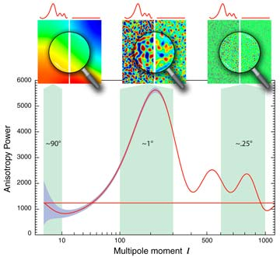
The Power Spectrum
A power spectrum is a plot of the amount of fluctuation (variations) of temperature (E) vs the angular (or linear) size
Fluctuation = difference in 2 measurements of a given quantity at corresponding points (ie measure fluctuation with 1 degree resolution, measure with 0.1 degree resolution, compare)
http://map.gsfc.nasa.gov/media/070950/070950b.jpg
Plot shows the sky's temperature when measured at different angular scales across the sky. The wiggly line is the actual measurement. The straight line is the same measurement of sky energy if there were a true uniform distribution of temperature. The sky images above three separate portions of the graph show their appearance under these two scenerios. A multiple moment is a Fourier series counterpart of angular size. Higher order multipole terms == smaller angular resolution.

Slide 6
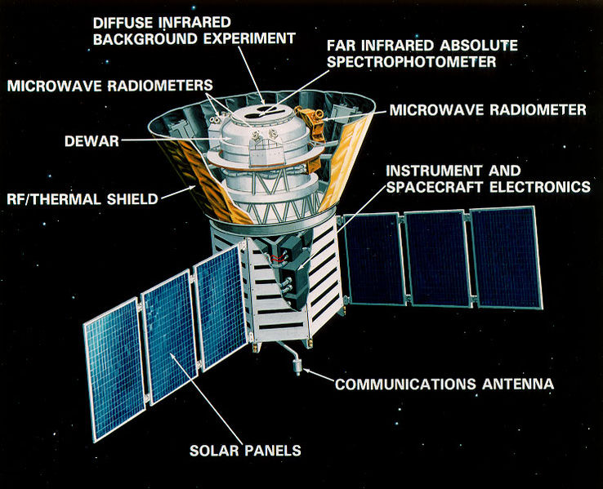
Cosmic Microwave Background
1992: COBE satellite detected the anisotropies in CMB (2.7251 vs 2.7249 K!)
T fluctuations related to fluctuations in matter in early universe, carry information about initial conditions for formation of cosmic structures
COBE has angular resolution of 7 degrees across sky, only sensitive to broad fluctuations
http://en.wikipedia.org/wiki/File:COBEDiagram.jpg

Slide 7
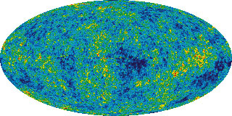
Wilkinson Microwave Anisotropy Probe
WMAP 7 year results released in 2010
Mapped temperature fluctuations of the CMB radiation with unprecedented resolution (up to l ~ 500), also measured polarization of CMB
Frequency 22 GHz 30 GHz 40 GHz 60 GHz 90 GHz
FWHM, degrees 0.93 0.68 0.53 0.35 <0.23

Slide 8
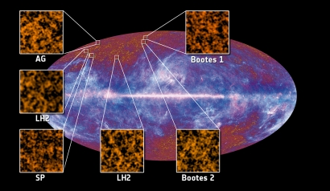
Planck
Planck mission measures CMB anisotropy and provides cosmic variance limited temperature measurements up to l ~ 2000
Improvements over WMAP:
higher resolution, x3 smaller scales
higher sensitivity, x10
observes in 9 frequency bands (vs 5)
2 instruments: Low Frequency and High Frequency
Notes:
L is the index used in spherical harmonic moments
Planck started it’s 4th survey in Feb 2011
Location on the sky of the first six fields used to detect the Cosmic Infrared Background antisotropies

Slide 9
Planck
Notes:
ANIMATION!

