Slide 1
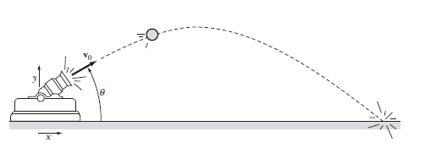
Trajectories and Air Resistance

Slide 2
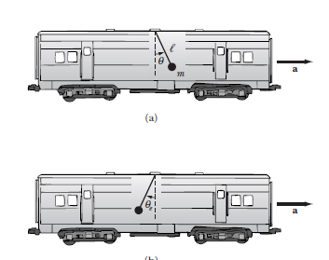
Inertial/Noninertial Frames of reference

Slide 3
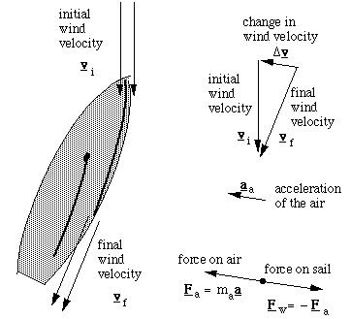
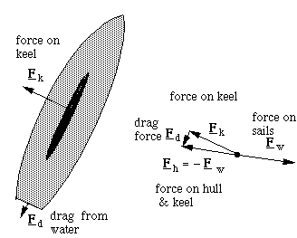
How does a boat sail upwind?
Aerodynamic Force Hydrodynamic Force

Slide 4
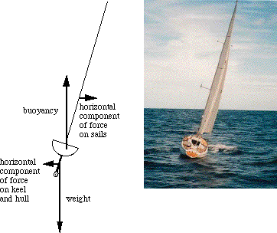
Balance of forces and torques

Slide 5
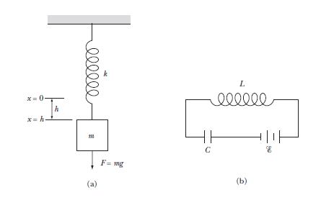
Electrical Analogue to a mechanical system

Slide 6
Driven System - Resonance

