Slide 1
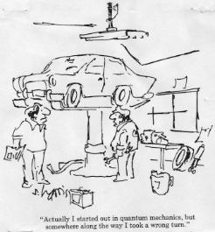

Slide 2
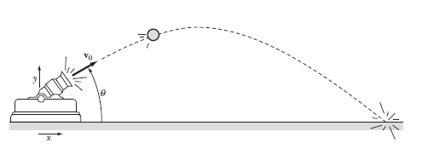
Trajectories and Air Resistance

Slide 3
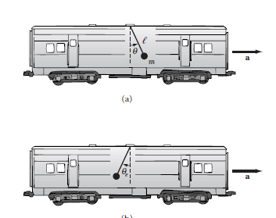
Inertial/Noninertial Frames of reference

Slide 4
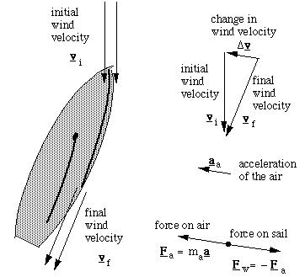
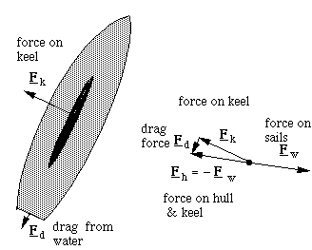
How does a boat sail upwind?
Aerodynamic Force Hydrodynamic Force

Slide 5
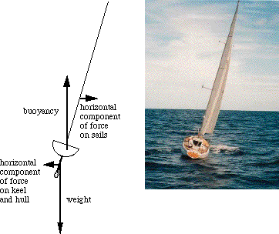
Balance of forces and torques

Slide 6
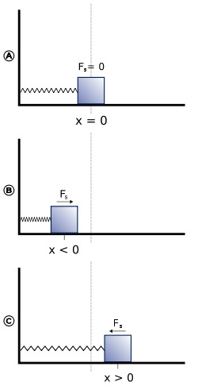
Spring–mass system in equilibrium (A),
compressed (B) and stretched (C) states.
Hook’s Law
F = -kx

Slide 7
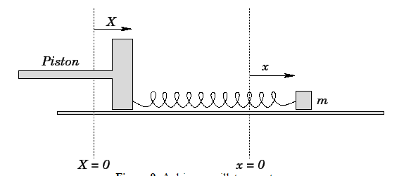
Driven Mechanical Oscillator

Slide 8
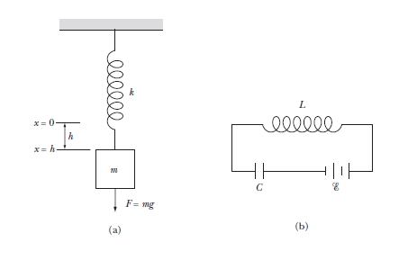
Electrical Analogue to a mechanical system

Slide 9
Driven System - Resonance

Slide 10
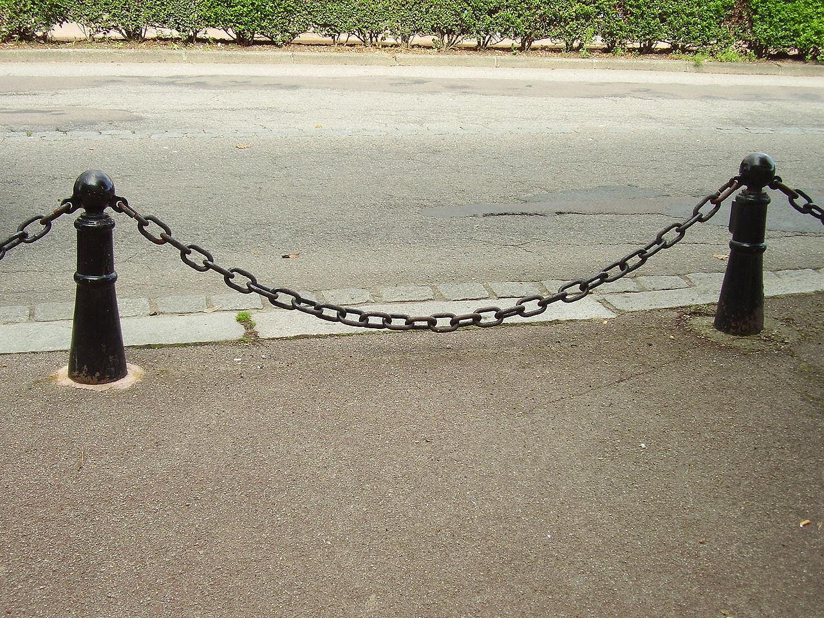
A hanging chain with short links forms a catenary

