Slide 1
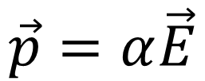
Insulator
p
+
_
+
_
+
_
+
_
$$\vec{p}=α\vec{E}$$
+
_
+
_
+
_
+
_
_
_
_
_
+
+
+
+
_
_
_
_
+
+
+
+
_
_
_
_
+
+
+
+
E

Slide 2
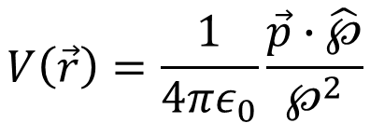

$$\vec{P}(\vec{r})≡$$
Dipole moment per unit volume
$$V\left(\vec{r}\right)=\frac{1}{4πε_{0}}\frac{\vec{p}∙\hat{℘}}{℘^{2}}$$
℘
$$V\left(\vec{r}\right)=\frac{1}{4πε_{0}}\int_{ν}{\frac{\vec{P}∙\hat{℘}}{℘^{2}}}dτ^{′}$$
$$\vec{p}$$
$$V\left(\vec{r}\right)=\frac{1}{4πε_{0}}\oint_{S}{\left(\frac{\vec{P}}{℘}\right)∙d\vec{a^{′}}}−\frac{1}{4πε_{0}}\int_{ν}{\frac{∇^{′}∙\vec{P}}{℘}}dτ^{′}$$

Slide 3
Insulator
p
+
_
+
_
+
_
+
_
$$\vec{p}=α\vec{E}$$
+
_
+
_
+
_
+
_
_
_
_
_
+
+
+
+
_
_
_
_
+
+
+
+
_
_
_
_
+
+
+
+
E

Slide 4
Insulator
p
+
_
+
_
+
_
+
_
$$\vec{p}=α\vec{E}$$
+
_
+
_
+
_
+
_
_
_
_
_
+
+
+
+
_
_
_
_
+
+
+
+
_
_
_
_
+
+
+
+
E

Slide 5
Insulator
_
_
_
_
_
_
_
_
_
_
_
_
_
_
+
+
+
+
+
+
+
+
+
+
+
+
+
+
+
_
+
_
+
_
+
_
+
_
+
_
+
_
+
_
+
_
+
_
+
_
+
_
+
_
+
_
a
+
_
+
_
+
_
+
_
+
_
+
_
+
_
+
_
+
_
+
_
+
_
+
_
+
_
+
_
R
_
_
_
_
_
_
_
_
_
_
_
_
_
_
+
+
+
+
+
+
+
+
+
+
+
+
+
+
_
_
_
_
_
_
_
_
_
_
_
_
_
_
+
+
+
+
+
+
+
+
+
+
+
+
+
+
_
_
_
_
_
_
_
_
_
_
_
_
_
_
+
+
+
+
+
+
+
+
+
+
+
+
+
+
_
_
_
_
_
_
_
_
_
_
_
_
_
_
+
+
+
+
+
+
+
+
+
+
+
+
+
+
L
L >> R ~ 1000a

Slide 6
Insulator
R
E_{in}
E_{out}
r

Slide 7
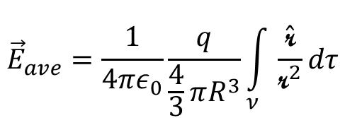
What is the average field over a sphere of radius R due to a charge q placed at a point A a distance r from the center of the sphere?
R
r
$${\vec{E}}_{ave}=\frac{1}{4πε_{0}}\frac{q}{\frac{4}{3}πR^{3}}\int_{ν}{\frac{\hat{\text{r}}}{{\text{r}}^{2}}dτ}$$
A
q
r

Slide 8
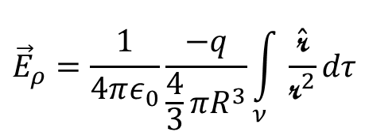
What is the electric field at the same point A if the charge -q were distributed uniformly over the sphere of radius R?
R
$${\vec{E}}_{ρ}=\frac{1}{4πε_{0}}\frac{−q}{\frac{4}{3}πR^{3}}\int_{ν}{\frac{\hat{\text{r}}}{{\text{r}}^{2}}dτ}$$
r /
A
r

Slide 9
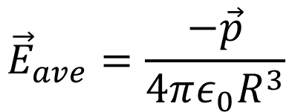
R
$${\vec{E}}_{ave}=\frac{−\vec{p}}{4πε_{0}R^{3}}$$
p
A
q

Slide 10
What is the average field over a sphere of radius R due to a charge q placed at a point A a distance r from the center of the sphere?
R
r
A
r
q

Slide 11
What is the electric field at the same point A if the charge -q were distributed uniformly over the sphere of radius R?
R
r
r /
A
r

Slide 12
Insulator
The macroscopic or average field:
$\vec{E}\left(\vec{r}\right)={\vec{E}}_{ave−outside}\left(\vec{r}\right)$+${\vec{E}}_{ave−intside}\left(\vec{r}\right)$
R
E_{in}
E_{out}
r

Slide 13
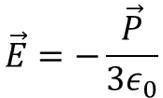
The macroscopic or average field:
$\vec{E}\left(\vec{r}\right)={\vec{E}}_{ave−outside}\left(\vec{r}\right)$+${\vec{E}}_{ave−inside}\left(\vec{r}\right)$
$$\vec{E}=−\frac{\vec{P}}{3ε_{0}}$$
Same as the field produced by all the charges outside the sphere at the center of the sphere
Same as the electric field inside a uniformly polarized sphere!
$$V\left(\vec{r}\right)=\frac{1}{4πε_{0}}\int_{ν_{out}}{\frac{\vec{P}∙\hat{\text{r} }}{{\text{r} }^{2}}}dτ^{′}$$
So if P does not vary much inside blue region…
$${\vec{E}}_{ave−inside}\left(\vec{r}\right)=\frac{1}{4πε_{0}}\int_{ν_{in}}{\frac{\vec{P}∙\hat{\text{r} }}{{\text{r} }^{2}}}dτ^{′}$$

