Slide 1
Solution to Laplace equation in 1D
$$\frac{d^{2}V}{dx^{2}}=0, ⇒V=mx+b$$
V
Mean value theorem in 1D
$$V\left(x\right)=\frac{1}{2}[V\left(x+a\right)+V\left(x−a\right)]$$
V(x-a)
V(x)
V(x+a)
x
x-a
x
x+a

Slide 2
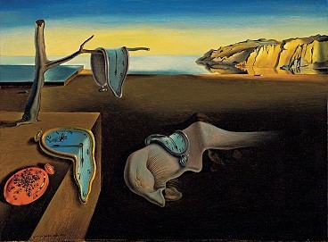
Mean value theorem in 2D
$$V\left(\vec{r_{P}}\right)=\frac{1}{2πR}\oint_{circle}{V\left(\vec{r}\right)dl}$$
V
y
$$\vec{r_{P}}$$
R
x

Slide 3
q
z
r
θ
R
Equipotentials
y
x

Slide 4

q
Mean value theorem in 3D
$$V\left(\vec{r}\right)=\frac{1}{4πR^{2}}\oint_{sphere}{Vda}$$
z
r
θ
$$da$$
R
y
x

Slide 5
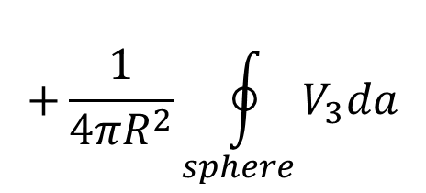
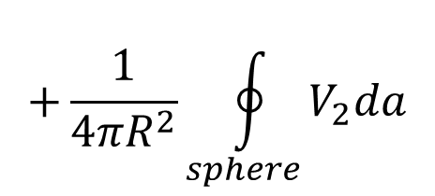
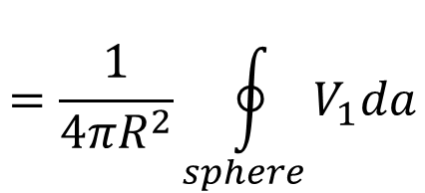
q₁
$$V_{ave}=\frac{1}{4πR^{2}}\oint_{sphere}{\left(V_{1}+V_{2}+V_{3}\right)da}$$
q₂
$$=\frac{1}{4πR^{2}}\oint_{sphere}{V_{1}da}$$
z
r
$$+\frac{1}{4πR^{2}}\oint_{sphere}{V_{2}da}$$
θ
$$da$$
R
y
$$+\frac{1}{4πR^{2}}\oint_{sphere}{V_{3}da}$$
q₃
$$=V_{1}\left(\vec{r}\right)+V_{2}\left(\vec{r}\right)+V_{3}\left(\vec{r}\right)$$
x
$$=V\left(\vec{r}\right)$$

Slide 6

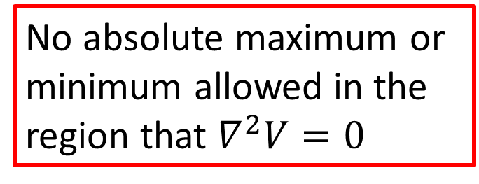
Mean value theorem
$$V\left(\vec{r}\right)=\frac{1}{4πR^{2}}\oint_{sphere}{Vda}$$
$$∇^{2}V=0$$
No absolute maximum or minimum allowed in the region that $∇^{2}V=0$

Slide 7
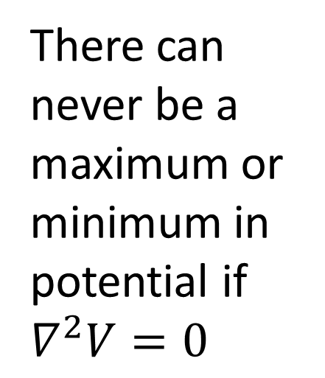
There can never be a maximum or minimum in potential if $∇^{2}V=0$

Slide 9
Let there be two possible potentials which are solutions to Laplace’s equation
Same boundary conditions
$$ν$$
$$ν$$
V₁
V₂

Slide 10
V₃ = V₁ - V₂

Slide 12
Let there be two possible solutions:
$$ν$$
$$∇∙\vec{E_{1}}=\frac{ρ}{ε_{0}}$$
Q₃
Charge density
$$ρ$$
$$∇∙\vec{E_{2}}=\frac{ρ}{ε_{0}}$$
Q₂
Q₁

Slide 13
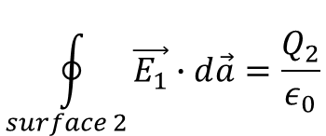
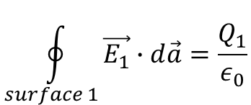
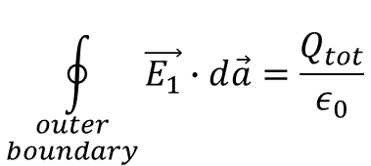
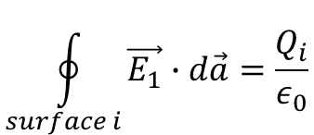
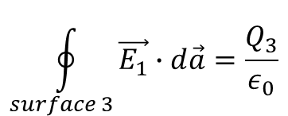
E = 0 inside the metallic regions
$$\oint_{surface 1}{\vec{E_{1}}∙d\vec{a}}=\frac{Q_{1}}{ε_{0}}$$
Q₃
$$\oint_{surface 2}{\vec{E_{1}}∙d\vec{a}}=\frac{Q_{2}}{ε_{0}}$$
Q₂
Q₁
$$\oint_{surface 3}{\vec{E_{1}}∙d\vec{a}}=\frac{Q_{3}}{ε_{0}}$$
$$\oint_{surface i}{\vec{E_{1}}∙d\vec{a}}=\frac{Q_{i}}{ε_{0}}$$
$$\oint_{\begin{aligned}outer \\ boundary\end{aligned}}{\vec{E_{1}}∙d\vec{a}}=\frac{Q_{tot}}{ε_{0}}$$

Slide 14
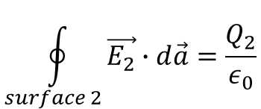
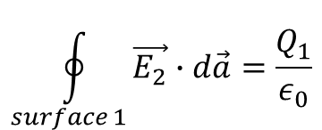
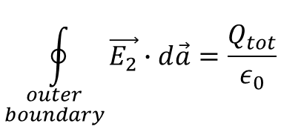
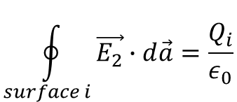
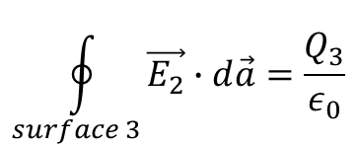
E = 0 inside the metallic regions
$$\oint_{surface 1}{\vec{E_{2}}∙d\vec{a}}=\frac{Q_{1}}{ε_{0}}$$
Q₃
$$\oint_{surface 2}{\vec{E_{2}}∙d\vec{a}}=\frac{Q_{2}}{ε_{0}}$$
Q₂
Q₁
$$\oint_{surface 3}{\vec{E_{2}}∙d\vec{a}}=\frac{Q_{3}}{ε_{0}}$$
$$\oint_{surface i}{\vec{E_{2}}∙d\vec{a}}=\frac{Q_{i}}{ε_{0}}$$
$$\oint_{\begin{aligned}outer \\ boundary\end{aligned}}{\vec{E_{2}}∙d\vec{a}}=\frac{Q_{tot}}{ε_{0}}$$

Slide 15
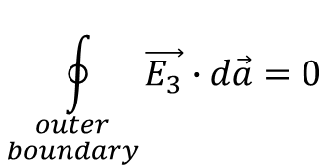
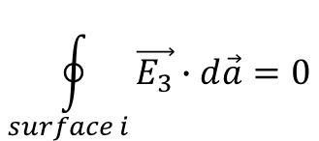
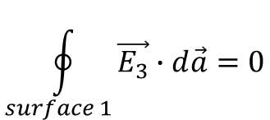
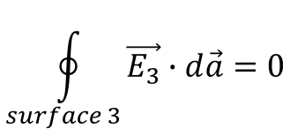
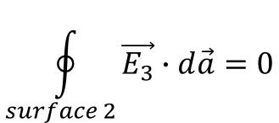
Let
$$\vec{E_{3}}≡\vec{E_{1}}−\vec{E_{2}}$$
$$∇∙\vec{E_{3}}=∇∙\left(\vec{E_{1}}−\vec{E_{2}}\right)=0$$
Q₃
$$\oint_{surface 1}{\vec{E_{3}}∙d\vec{a}}=0$$
Q₂
$$\oint_{surface 2}{\vec{E_{3}}∙d\vec{a}}=0$$
Q₁
$$\oint_{surface 3}{\vec{E_{3}}∙d\vec{a}}=0$$
$$\oint_{surface i}{\vec{E_{3}}∙d\vec{a}}=0$$
$$\oint_{\begin{aligned}outer \\ boundary\end{aligned}}{\vec{E_{3}}∙d\vec{a}}=0$$

Slide 16
The corresponding potentials
$$V_{1},V_{2},V_{3}$$
are constants at the surfaces of the conductors.
Q₃
$$∇∙\left(V_{3}\vec{E_{3}}\right)=V_{3}\left(∇∙\vec{E_{3}}\right)+\vec{E_{3}}∙\left(∇V_{3}\right)$$
$$=0−E_{3}^{2}$$
Q₂
Q₁

