Slide 1

y
V =0
a
V =V₀
x
b
b
V =0
z
$$∇^{2}V=0$$

Slide 2
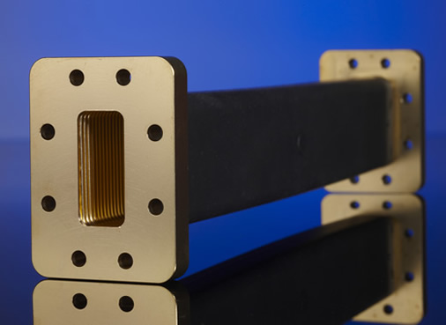
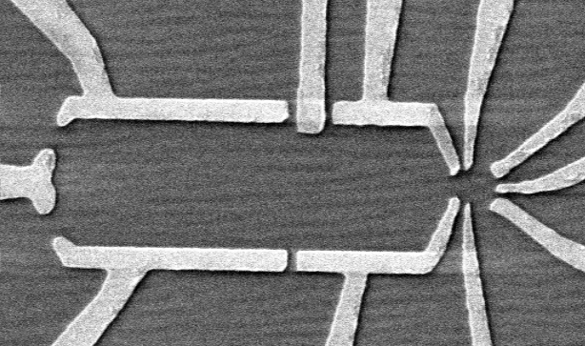

Slide 3
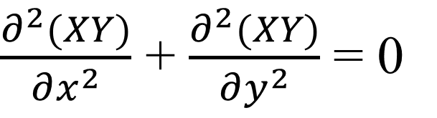
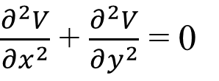
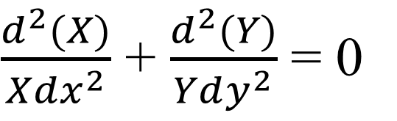

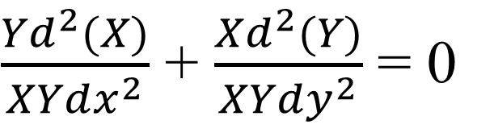

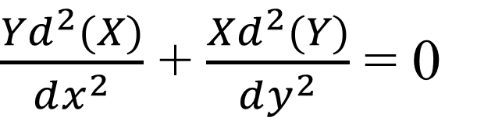
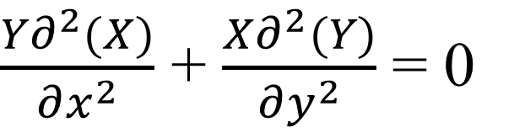
$$∇^{2}V=0$$
$\frac{∂^{2}V}{∂x^{2}}$ + $\frac{∂^{2}V}{∂y^{2}}$ = 0
$$V\left(x,y\right)=X\left(x\right)Y(y)$$
$\frac{∂^{2}(XY)}{∂x^{2}}$ + $\frac{∂^{2}(XY)}{∂y^{2}}$ = 0
$\frac{{Yd}^{2}(X)}{dx^{2}}$ + $\frac{{Xd}^{2}(Y)}{dy^{2}}$ = 0
$\frac{{Y∂}^{2}(X)}{∂x^{2}}$ + $\frac{{X∂}^{2}(Y)}{∂y^{2}}$ = 0
$\frac{{Yd}^{2}(X)}{XYdx^{2}}$ + $\frac{{Xd}^{2}(Y)}{XYdy^{2}}$ = 0
$\frac{d^{2}(X)}{Xdx^{2}}$ + $\frac{d^{2}(Y)}{Ydy^{2}}$ = 0

Slide 4
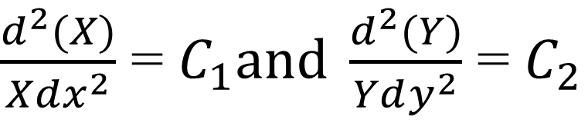
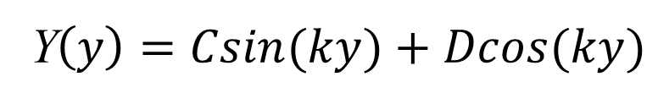
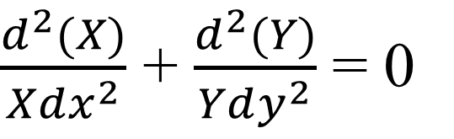

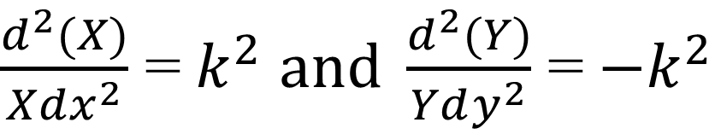
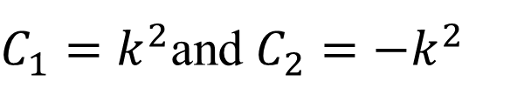
$\frac{d^{2}(X)}{Xdx^{2}}$ + $\frac{d^{2}(Y)}{Ydy^{2}}$ = 0
$$X\left(x\right)=Ae^{kx}+Be^{−kx}$$
Y$\left(y\right)=Csin(ky)+Dcos(ky)$
$\frac{d^{2}(X)}{Xdx^{2}}$ = $C_{1}and \frac{d^{2}(Y)}{Ydy^{2}}$ = $C_{2}$
$C_{1}=k^{2}$and $C_{2}={−k}^{2}$
Completely general up to this point
$\frac{d^{2}(X)}{Xdx^{2}}$ =${ k}^{2}$ $and \frac{d^{2}(Y)}{Ydy^{2}}$ =${ −k}^{2}$

Slide 5



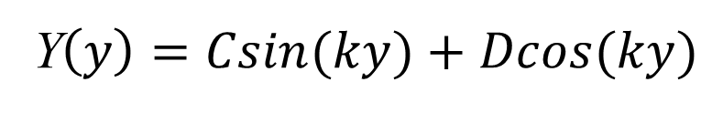
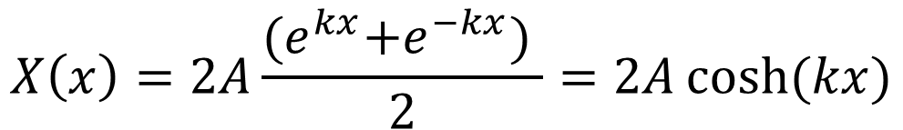
$$X\left(x\right)=Ae^{kx}+Be^{−kx}$$
Y$\left(y\right)=Csin(ky)+Dcos(ky)$
Boundary conditions
Symmetric in x:
$$⟹A=B$$
$$X\left(x\right)=A{(e}^{kx}+e^{−kx})$$
$$X\left(x\right)=2A\frac{{(e}^{kx}+e^{−kx}) }{2}=2A\cosh{(kx)}$$
$$⟹V\left(x,y\right)=2A\cosh{(kx)(Csin\left(ky\right)+Dcos\left(ky\right))}$$
$$⟹V\left(x,y\right)=\cosh{(kx)(Csin\left(ky\right)+Dcos\left(ky\right))}$$

Slide 6


$$⟹V\left(x,y\right)=\cosh{(kx)(Csin\left(ky\right)+Dcos\left(ky\right))}$$
$$⟹V\left(x,0\right)=0=cosh{(kx)(Csin\left(0\right)+Dcos\left(0\right))}$$
$$⟹V\left(x,0\right)=0={Dcos\left(0\right))}$$
$$⟹V\left(x,y\right)=Ccosh{(kx)sin\left(ky\right)}$$
$$⟹V\left(x,a\right)=0=Ccosh{(kx)sin\left(ka\right)}$$
$$⟹ka=nπ$$
$$⟹V\left(x,y\right)=Ccosh{(nπx/a)sin\left(nπy/a\right)}$$

Slide 7

$$⟹V\left(x,y\right)=Ccosh{(nπx/a)sin\left(nπy/a\right)}$$
$$n=0,1,2,3…$$
One boundary condition to go

Slide 8

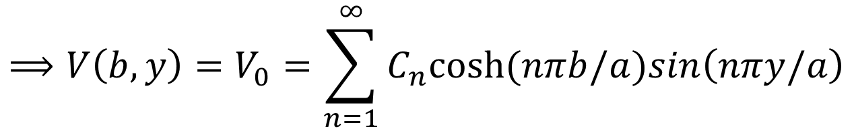
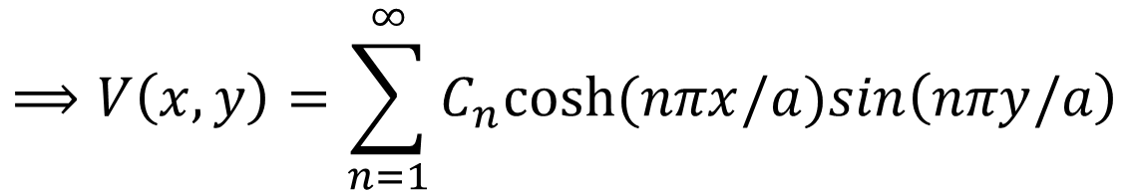
$$⟹V\left(x,y\right)=Ccosh{(nπx/a)sin\left(nπy/a\right)}$$
$$n=0,1,2,3…$$
$$⟹V\left(b,y\right)=V_{0}=Ccosh{(nπb/a)sin\left(nπy/a\right)}$$
Never going to happen
$$⟹V\left(x,y\right)=C_{n}cosh{(nπx/a)sin\left(nπy/a\right)}$$
$$⟹V\left(x,y\right)=\sum_{n=1}^{∞}{C_{n}cosh{(nπx/a)sin\left(nπy/a\right)}}$$
$$⟹V\left(b,y\right)=V_{0}=\sum_{n=1}^{∞}{C_{n}cosh{(nπb/a)sin\left(nπy/a\right)}}$$

Slide 9
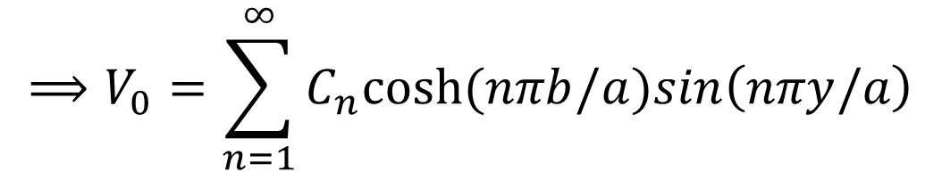
$$⟹V_{0}=\sum_{n=1}^{∞}{C_{n}cosh{(nπb/a)sin\left(nπy/a\right)}}$$

Slide 10
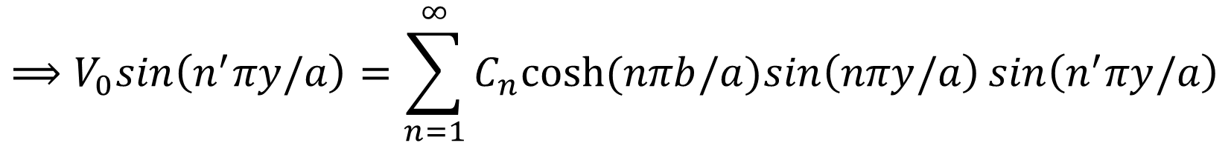
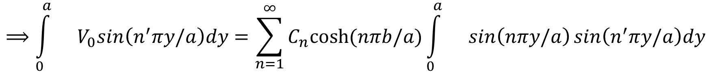
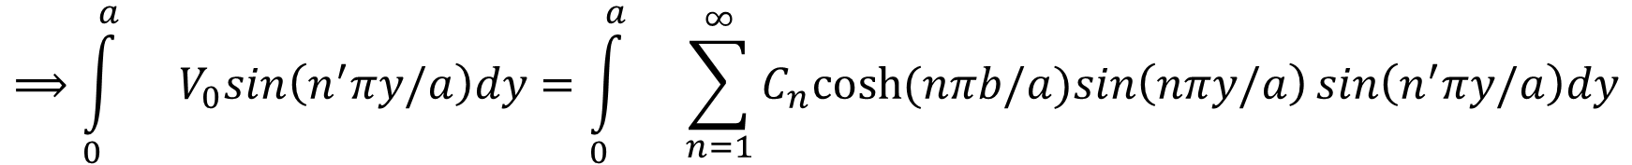
$$⟹V_{0}=\sum_{n=1}^{∞}{C_{n}cosh{(nπb/a)sin\left(nπy/a\right)}}$$
$$⟹V_{0}sin\left(n^{′}πy/a\right)=\sum_{n=1}^{∞}{C_{n}cosh{(nπb/a)sin\left(nπy/a\right)}}sin\left(n^{′}πy/a\right)$$
$$⟹{\int_{0}^{a}{}V}_{0}sin\left(n^{′}πy/a\right)dy=\int_{0}^{a}{}\sum_{n=1}^{∞}{C_{n}cosh{(nπb/a)sin\left(nπy/a\right)}}sin\left(n^{′}πy/a\right)dy$$
$$⟹{\int_{0}^{a}{}V}_{0}sin\left(n^{′}πy/a\right)dy=\sum_{n=1}^{∞}{C_{n}cosh{(nπb/a)\int_{0}^{a}{}sin\left(nπy/a\right)}}sin\left(n^{′}πy/a\right)dy$$

Slide 11
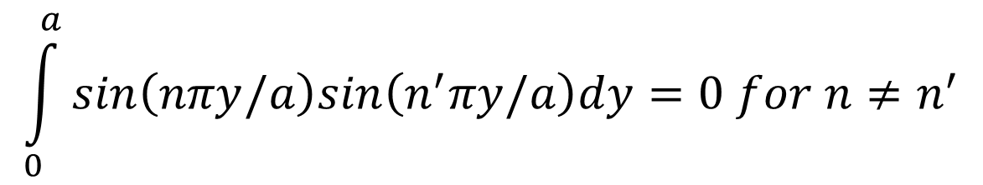
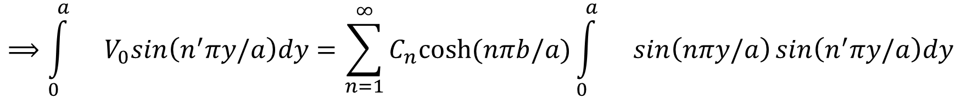
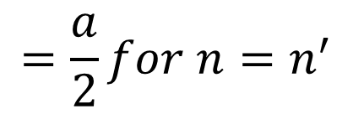
$$⟹{\int_{0}^{a}{}V}_{0}sin\left(n^{′}πy/a\right)dy=\sum_{n=1}^{∞}{C_{n}cosh{(nπb/a)\int_{0}^{a}{}sin\left(nπy/a\right)}}sin\left(n^{′}πy/a\right)dy$$
$$\int_{0}^{a}{sin\left(nπy/a\right)sin\left(n^{′}πy/a\right)dy}=0 for n≠n^{′}$$
$$=\frac{a}{2}for n=n^{′}$$
Orthogonal, complete set of functions

Slide 12
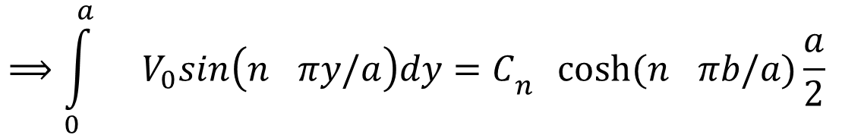
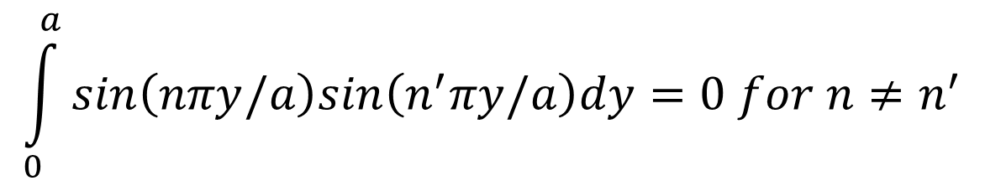
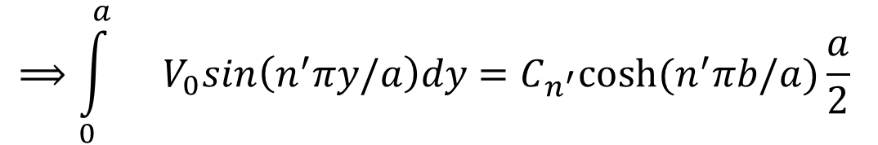
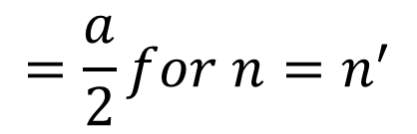
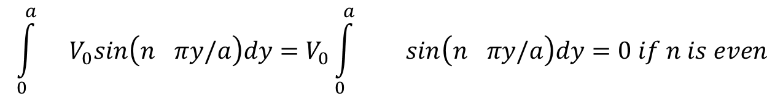
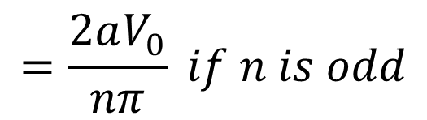
$$⟹{\int_{0}^{a}{}V}_{0}sin\left(n^{′}πy/a\right)dy=\sum_{n=1}^{∞}{C_{n}cosh{(nπb/a)\int_{0}^{a}{}sin\left(nπy/a\right)}}sin\left(n^{′}πy/a\right)dy$$
$$\int_{0}^{a}{sin\left(nπy/a\right)sin\left(n^{′}πy/a\right)dy}=0 for n≠n^{′}$$
$$=\frac{a}{2}for n=n^{′}$$
$$⟹{\int_{0}^{a}{}V}_{0}sin\left(n^{′}πy/a\right)dy=C_{n^{′}}cosh{(n^{′}πb/a)\frac{a}{2} }$$
$$⟹{\int_{0}^{a}{}V}_{0}sin\left(n^{}πy/a\right)dy=C_{n^{}}cosh{(n^{}πb/a)\frac{a}{2} }$$
$${\int_{0}^{a}{}V}_{0}sin\left(n^{}πy/a\right)dy={V_{0}\int_{0}^{a}{}}_{}sin\left(n^{}πy/a\right)dy=0 if n is even$$
$$=\frac{2aV_{0}}{nπ} if n is odd$$

Slide 13
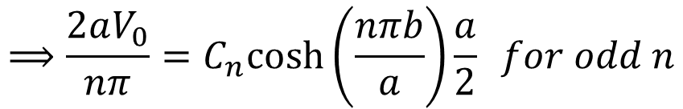
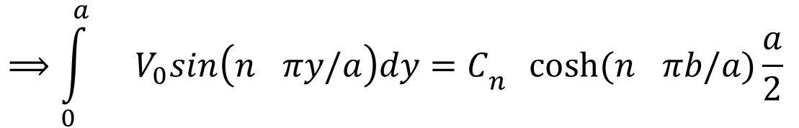
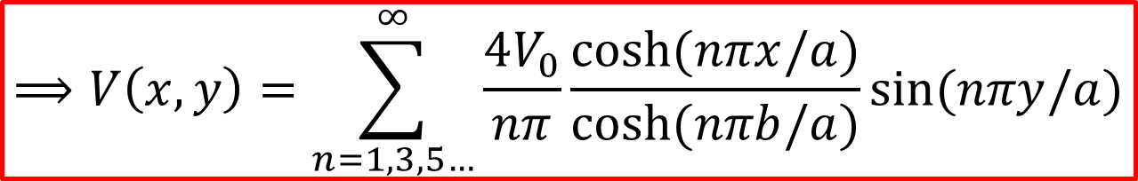
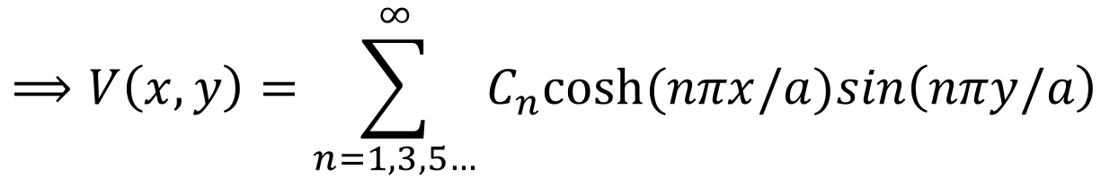
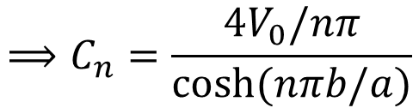
$$⟹{\int_{0}^{a}{}V}_{0}sin\left(n^{}πy/a\right)dy=C_{n^{}}cosh{(n^{}πb/a)\frac{a}{2} }$$
$$⟹\frac{2aV_{0}}{nπ}=C_{n}cosh\left(\frac{nπb}{a}\right)\frac{a}{2} for odd n$$
$$⟹C_{n}=\frac{4V_{0}/nπ}{\cosh{(nπb/a)}}$$
$$⟹V\left(x,y\right)=\sum_{n=1,3,5…}^{∞}{C_{n}cosh{(nπx/a)sin\left(nπy/a\right)}}$$
$$⟹V\left(x,y\right)=\sum_{n=1,3,5…}^{∞}{\frac{4V_{0}}{nπ}\frac{\cosh{(nπx/a)}}{\cosh{(nπb/a)}}\sin{(nπy/a)}}$$

Slide 14
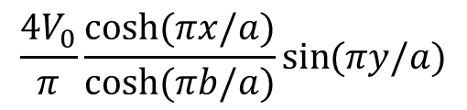

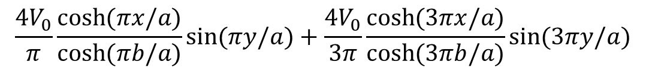
$$⟹V\left(x,y\right)=\sum_{n=1,3,5…}^{∞}{\frac{4V_{0}}{nπ}\frac{\cosh{(nπx/a)}}{\cosh{(nπb/a)}}\sin{(nπy/a)}}$$
$$\frac{4V_{0}}{π}\frac{\cosh{(πx/a)}}{\cosh{(πb/a)}}\sin{(πy/a)}$$
$$\frac{4V_{0}}{π}\frac{\cosh{(πx/a)}}{\cosh{(πb/a)}}\sin{(πy/a)}+\frac{4V_{0}}{3π}\frac{\cosh{(3πx/a)}}{\cosh{(3πb/a)}}\sin{(3πy/a)}$$

Slide 15
Matlab code to visualize V(x,y)
[x,y]=meshgrid(-50:1:50,0:1:100);
v=0;
for i=1:100
v=v+(4./pi)*(cosh(((2*i-1)*pi*x)/100).*sin((2*i-1)*pi*y/100))/((2*i-1)*cosh((2*i-1)*pi/2));
surf(v);
view(-27,38);
end
surf(v)
axis([0 100 0 100 0 1])
view(-27,38)

Slide 16
Numerical technique to solve the same problem (relaxation method)
Uses mean-value theorem
Create a 100 × 100 grid for V(x,y) or V(i,j)
Impose the boundary conditions first by setting initial values for certain V(i,j)
Generate V(i,j) for the entire grid by using mean value theorem:
V(i,j)= (V(i-1,j-1)+V(i,j-1)+V(i+1,j-1)+V(i+1,j)+V(i+1,j+1)+V(i,j+1)+V(i-1,j+1)+V(i-1,j))/8;
5. Iterate many times till you reach equilibrium (hence relaxation).
V(i-1,j+1)
V(i,j+1)
V(i+1,j+1)
V(i,j)
V(i-1,j)
V(i+1,j)
V(i-1,j-1)
V(i,j-1)
V(i+1,j-1)

Slide 17
Numerical technique to solve the same problem (relaxation method): MATLAB code
%create 100 by 100 grid for V(i,j)
for i=1:100
for j=1:100
V(i,j)=0;
end
end
%Impose the boundary conditions first by setting initial values for certain V(i,j)
for i=1:100
V(i,1)=1;
V(i,100)=1;
end
surf(V)
view(-27,38);
pause %pause for effect
for k = 1:5000 %iterate 5000 times
for i = 2:99
for j = 2:99
V(i,j)= (V(i-1,j-1)+V(i,j-1)+V(i+1,j-1)+V(i+1,j)+V(i+1,j+1)+V(i,j+1)+V(i-1,j+1)+V(i-1,j))/8; %mean value theorem
end
end
surf(V)
view(-27,38)
pause(0.005)
end

