Slide 1
Conductor
+
_
+
_
+
_
+
_
+
_
+
_
+
_
+
_
_
_
_
_
+
+
+
+
_
_
_
_
+
+
+
+
_
_
_
_
+
+
+
+
E

Slide 2
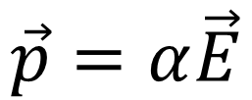
Insulator
p
+
_
+
_
+
_
+
_
$$\vec{p}=α\vec{E}$$
+
_
+
_
+
_
+
_
_
_
_
_
+
+
+
+
_
_
_
_
+
+
+
+
_
_
_
_
+
+
+
+
E

Slide 3
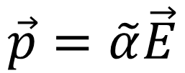
$$\vec{p}=\tilde{α}\vec{E}$$
$$\vec{N}=\vec{p}×\vec{E}$$
$$\vec{F}=(\vec{p}∙∇)\vec{E}$$

Slide 4
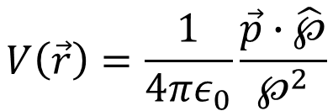
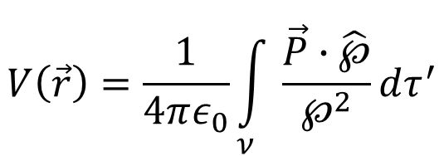
$$\vec{P}(\vec{r})≡$$
Dipole moment per unit volume
$$V\left(\vec{r}\right)=\frac{1}{4πε_{0}}\frac{\vec{p}∙\hat{℘}}{℘^{2}}$$
℘
$$V\left(\vec{r}\right)=\frac{1}{4πε_{0}}\int_{ν}{\frac{\vec{P}∙\hat{℘}}{℘^{2}}}dτ^{′}$$
$$\vec{p}$$
$$V\left(\vec{r}\right)=\frac{1}{4πε_{0}}\oint_{S}{\left(\frac{\vec{P}}{℘}\right)∙d\vec{a^{′}}}−\frac{1}{4πε_{0}}\int_{ν}{\frac{∇^{′}∙\vec{P}}{℘}}dτ^{′}$$

Slide 5
$$V\left(\vec{r}\right)=\frac{1}{4πε_{0}}\oint_{S}{\left(\frac{\vec{P}}{℘}\right)∙d\vec{a^{′}}}−\frac{1}{4πε_{0}}\int_{ν}{\frac{∇^{′}∙\vec{P}}{℘}}dτ^{′}$$
$$\hat{n}$$
$$\vec{P}∙d\vec{a^{′}}=\vec{P}∙\hat{n}da^{′}=σ_{b}da^{′}$$
℘
$$\hat{n}$$
$$\vec{P}∙\hat{n}=σ_{b}$$
$$\vec{p}$$
$$−∇∙\vec{P}=ρ_{b}$$

Slide 6
p
_
_
_
_
_
_
_
_
+
+
+
+
+
+
+
+

Slide 7
p
_
+
A

Slide 8
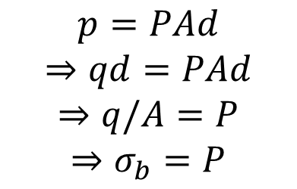
p
_
+
d
$$p=PAd$$
$$⇒qd=PAd$$
$$⇒q/A=P$$
$$⇒σ_{b}=P$$
A
A

Slide 9
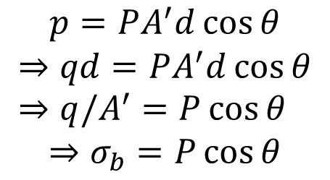
p
_
+
d
$$p=PA^{′}d\cos{θ}$$
$$⇒qd=PA^{′}d\cos{θ}⇒q/A^{′}=P\cos{θ}$$
$$⇒σ_{b}=P\cos{θ}$$
P
A’
θ
$$\hat{n}$$
A
$$\vec{P}∙\hat{n}=σ_{b}$$

Slide 10
+
+
+
_
_
_
+
_
_
_
_
+
_
+
+
+
$$∯_{S}{σ_{b}da=∯_{S}{\vec{P}∙\hat{n}da}}$$
Amount of charge pushed to the surface =
$$−∯_{S}{\vec{P}∙\hat{n}da}=−\int_{ν}{\left(∇∙\vec{P}\right)dτ}=\int_{ν}{ρ_{b}dτ}$$
Whats left in the volume =
$$−∇∙\vec{P}=ρ_{b}$$

