Slide 1
A generalized heat engine
p
$$W$$
V
Could be reversible or irreversible

Slide 2
A generalized heat engine
$$T_{i}$$
$$dQ_{i}$$
$$W$$
Absorbs an amount of heat from a body at temperature $T_{i}$ for an infinitesimal part of the cycle.
$$dQ_{i}$$

Slide 3
Since the work done on/by the gas along the adiabats cancel each other out, bringing them closer to each other reduces the total work done by the Carnot engine.
$$p_{A},V_{A},T_{A}$$
Isotherm 1
p
$$p_{B},V_{B},T_{B}$$
Adiabat 2
Adiabat 1
$$p_{D},V_{D},T_{D}$$
Isotherm 2
$$p_{C},V_{C},T_{C}$$
V

Slide 4
Since the work done on/by the gas along the adiabats cancel each other out, bringing them closer to each other reduces the total work done by the Carnot engine.
$$p_{A},V_{A},T_{A}$$
Isotherm 1
p
$$p_{B},V_{B},T_{B}$$
Work done by the gas is then $đW=đQ_{h}+đQ_{l}$
$$⇒đQ_{h}=đW−đQ_{l}→(1)$$
$$đW$$
Adiabat 2
Adiabat 1
$$p_{D},V_{D},T_{D}$$
$$p_{C},V_{C},T_{C}$$
Isotherm 2
V

Slide 5
A generalized heat engine
$$T$$
$$dW_{i}^{′}$$
$$dQ_{i}^{′}$$
$$T_{i}$$
$$dQ_{i}$$
$$W$$
Set up a Carnot engine which absorbs an amount of heat $đQ_{h}=đW_{i}^{′}−đQ_{i}^{′}$, does work $đW_{i}^{′}$ and rejects heat $đQ_{i}^{′}$ to the body at temperature $T_{i}$ (using (1))
Adjust the Carnot cycle such that $\left|đQ_{i}^{′}\right|=\left|{đQ}_{i}\right|⇒đQ_{i}^{′}=−{đQ}_{i}$

Slide 6
For each “narrow” Carnot engine:
$$\frac{{đQ}_{h}}{T_{h}}+\frac{{đQ}_{l}}{T_{l}}=0$$
$$⇒\frac{đW_{i}^{′}−đQ_{i}^{′}}{T}+\frac{đQ_{i}^{′}}{T_{i}}=0$$
$$⇒\frac{đW_{i}^{′}+đQ_{i}}{T}−\frac{đQ_{i}}{T_{i}}=0$$
$$⇒đW_{i}^{′}=đQ_{i}\left(\frac{T}{T_{i}}−1\right)$$

Slide 7
A generalized heat engine
$$T$$
$$dW_{i}$$
$$dQ_{i}$$
$$T_{i}$$
$$dQ_{i}$$
$$dW_{i}$$
$$dQ_{i}$$
$$W$$
$$dQ_{i}$$
$$T_{i}$$
In each infinitesimal segment of the engine cycle it absorbs an amount of heat $đQ_{i}$ from a body at temperature $T_{i}$ ($T_{i}$ is different for each segment).
For the generalized heat engine:
$$∆U=∆Q+∆W⇒∆Q=−∆W=W$$
($∆U=0$ for the cycle and $W$ is the work done by the engine)
$$⇒W=∆Q=\sum_{cycle}{đQ_{i}}$$

Slide 8
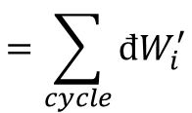
Work done by all the little Carnot engines
$$=\sum_{cycle}{đW_{i}^{′}}$$
Also $đW_{i}^{′}=đQ_{i}\left(\frac{T}{T_{i}}−1\right)$
$$⇒\sum_{cycle}{đW_{i}^{′}}=T\sum_{cycle}{\frac{đQ_{i}}{T_{i}}}−\sum_{cycle}{đQ_{i}}$$
$$⇒\sum_{cycle}{đW_{i}^{′}}=T\sum_{cycle}{\frac{đQ_{i}}{T_{i}}}−W$$
$$⇒\sum_{cycle}{đW_{i}^{′}}+W=T\sum_{cycle}{\frac{đQ_{i}}{T_{i}}}$$
What is the overall effect of all the little Carnot engines and the main generalized engine?
Each Carnot engine absorbs heat $đW_{i}^{′}+đQ_{i}$ from the reservoir at temperature $T$ and reject an amount of heat $đQ_{i}$ to the body at temperature $T_{i}$. The main engine absorbs all the heat rejected by the little Carnot engines and produces an amount of work $W$.

Slide 9
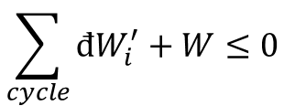
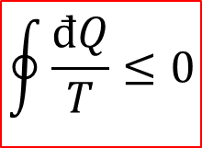
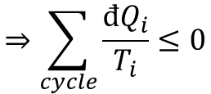
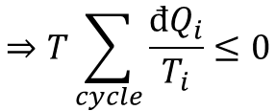
What is the overall effect of all the little Carnot engines and the main generalized engine?
Each Carnot engine absorbs heat $đW_{i}^{′}+đQ_{i}$ from the reservoir at temperature $T$ and reject an amount of heat $đQ_{i}$ to the body at temperature $T_{i}$. The main engine absorbs all the heat rejected by the little Carnot engines and produces an amount of work $W$.
Violates Kelvin-Planck statement of the second law unless the total work done:
$$\sum_{cycle}{đW_{i}^{′}}+W≤0$$
$$⇒T\sum_{cycle}{\frac{đQ_{i}}{T_{i}}}≤0$$
Since $T>0$
$$⇒\sum_{cycle}{\frac{đQ_{i}}{T_{i}}}≤0$$
i.e.
$$\oint{\frac{đQ}{T}}≤0$$
Claussius inequality

Slide 10
A generalized heat engine
$$T$$
$$dW_{i}$$
$$dQ_{i}$$
$$T_{i}$$
$$dQ_{i}$$
$$dW_{i}$$
$$dQ_{i}$$
$$W$$
$$dQ_{i}$$
$$T_{i}$$

Slide 11
A generalized heat engine
$$T$$
$$dW_{i}$$
$$dQ_{i}$$
$$T_{i}$$
$$dQ_{i}$$
$$dW_{i}$$
$$dQ_{i}$$
$$W$$
$$dQ_{i}$$
$$T_{i}$$
The Claussius inequality shows that the main engine needs to reject some of the heat it absorbs from the tiny Carnot engines, which means some of the tiny Carnot engines are actually tiny Carnot refrigerators putting some heat back to the reservoir at temperature $T$.

Slide 12
A generalized reversible heat engine
$$T$$
$$dW_{i}$$
$$dQ_{i}$$
$$T_{i}$$
$$dQ_{i}$$
$$dW_{i}$$
$$dQ_{i}$$
$$W$$
$$dQ_{i}$$
$$T_{i}$$
Hence, all the heat absorbed from the reservoir at temperature $T$ by the Carnot engines is put back in the reservoir by the Carnot refrigerators. If the main engine is irreversible, some dissipative work has been done and the total work $\sum_{cycle}{đW_{i}^{′}}+W<0$whereas, if the main engine is reversible, no dissipative work has been done and $\sum_{cycle}{đW_{i}^{′}}+W=0$

Slide 13
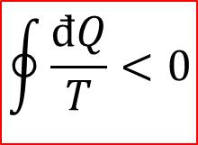
Hence:
For a general cycle:
$$\oint{\frac{đQ}{T}}≤0$$
For an irreversible cycle:
$$\oint{\frac{đQ}{T}}<0$$
For a reversible cycle:
$$\oint{\frac{đQ_{rev}}{T}}=0$$

Slide 14
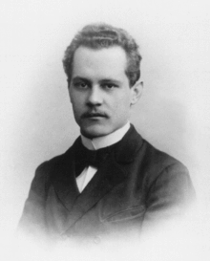
Arnold Sommerfeld
Thermodynamics is a funny subject. The first time you go through it, you don't understand it at all. The second time you go through it, you think you understand it, except for one or two small points. The third time you go through it, you know you don't understand it, but by that time you are so used to it, so it doesn't bother you any more.

