Slide 1
Thermal Physics
Too many particles… can’t keep track!
Use pressure (p) and volume (V) instead.
Temperature (T) measures the tendency of an object to spontaneously give up/absorb energy to/from its surroundings. (p and T will turn out to be related to the too many particles mentioned above)

Slide 2
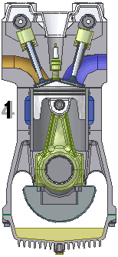
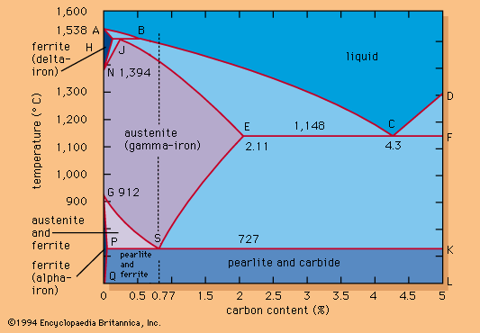
Pressure, Volume, Temperature
P, V, T
F/A
L³
Something to do with heat

Slide 3
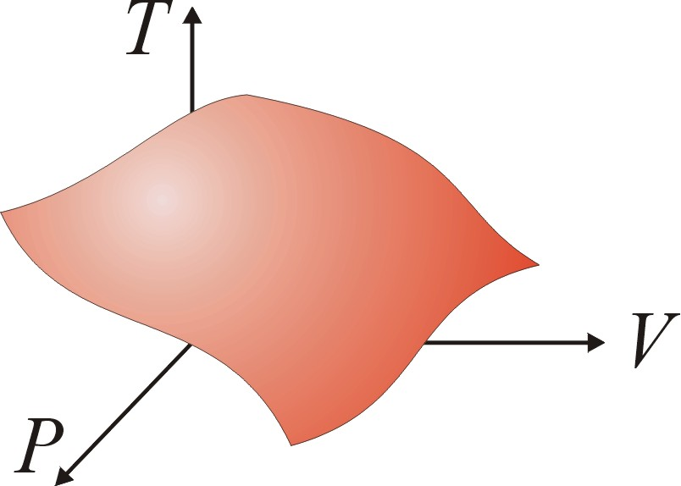
Equations of state
An equation of state is a mathematical relation between state variables, e.g. p, V & T.
This reduces the number of independent variables to two.
General form: f (p,V,T) = 0
Example: pV – nRT = 0 (ideal gas law)
Defines a 2D surface in p-V-T state space.
Each point on this surface represents an unique state of the system.
f (p,V,T) = 0
Equilibrium state

Slide 4
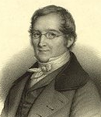
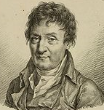
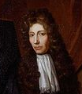
Ideal gas equation of state
Boyle’s law
p ∝ 1/V
Robert Boyle (1627 – 1691)
Charles’ law
pV = Nk_{B} T
V ∝ T
Jacques Charles (1746 – 1823)
k_{B} = 1.38 × 10⁻²³ J/K
Gay-Lussac’ law
p ∝ T
Joseph Louis Gay-Lussac (1778 - 1850)

Slide 5
Heat is energy in transit
Universe (system + surroundings)
Surroundings
System
Heat

Slide 6
What is temperature?
Temperature is what you measure with a thermometer
Temperature is the thing that’s the same for two objects, after they’ve been in contact long enough.
Long enough so that the two objects are in thermal equilibrium.
Time required to reach thermal equilibrium is the relaxation time.

Slide 7
Zeroth law of thermodynamics
If two systems are separately in thermal equilibrium with a third system, they are in thermal equilibrium with each other.
A
C
Diathermal wall
C can be considered the thermometer. If C is at a certain temperature then A and B are also at the same temperature.
B
C

Slide 8
How can we define temperature using the microscopic properties of a system?

Slide 9
Most likely macrostate the system will find itself in is the one with the maximum number of microstates.
Number of Microstates (Ω)
Macrostate

Slide 10
Each microstate is equally likely
The microstate of a system is continually changing
Given enough time, the system will explore all possible microstates and spend equal time in each of them (ergodic hypothesis).

Slide 11
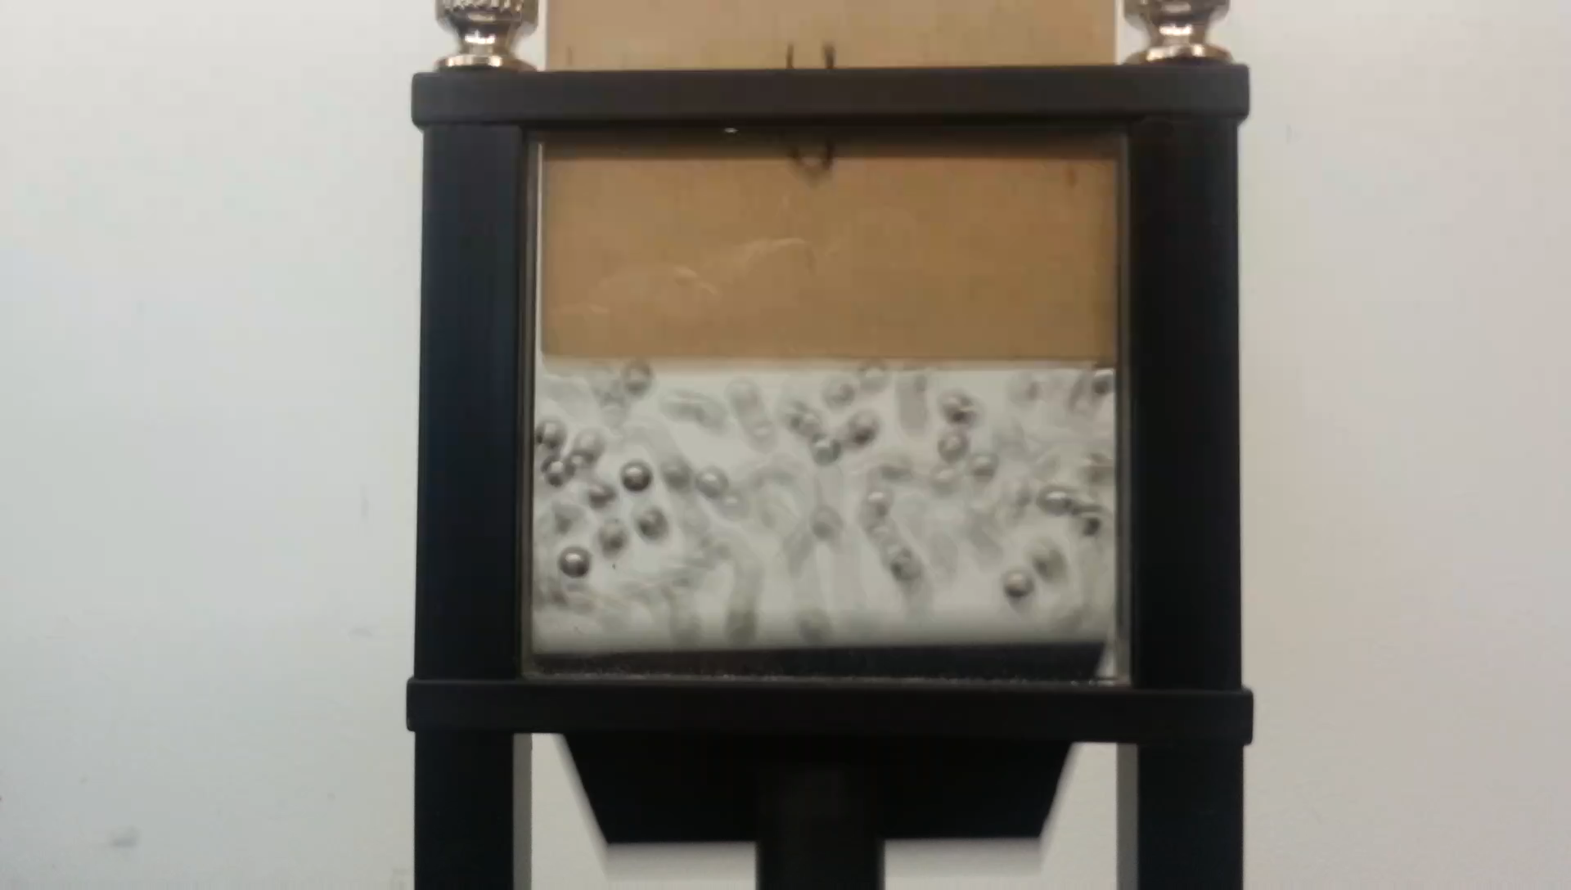

Slide 12
Most likely macrostate the system will find itself in is the one with the maximum number of microstates.
E₁
Ω₁(E₁)
E₂
Ω₂(E₂)
E
Ω(E)

Slide 13

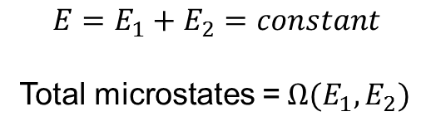
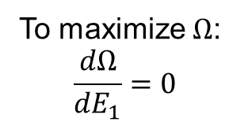
Most likely macrostate the system will find itself in is the one with the maximum number of microstates.
$$E=E_{1}+E_{2}=constant$$
Total microstates =$Ω(E_{1},E_{2})$
$$Ω\left(E_{1},E_{2}\right)=Ω_{1}(E_{1})Ω_{2}(E_{2})$$
To maximize $Ω$:
$$\frac{dΩ}{dE_{1}}=0$$
E₁
Ω₁(E₁)
E₂
Ω₂(E₂)
E₁
Ω₁(E₁)
E₂
Ω₂(E₂)

Slide 14
Most likely macrostate the system will find itself in is the one with the maximum number of microstates.
E₁
Ω₁(E₁)
E₂
Ω₂(E₂)

Slide 15
Using this definition of temperature we need to describe real systems

Slide 16
E
Ω(E)
Microcanonical ensemble: An ensemble of snapshots of a system with the same N, V, and E

Slide 17
Canonical ensemble: An ensemble of snapshots of a system with the same N, V, and T (red box with energy ε << E.
E-ε
Ω(E-ε)
ε
Ω^{I}(ε)
Red box is small only in terms of energy, its volume could still be large

Slide 19
Boltzmann Factor (canonical ensemble)

Slide 20
Canonical ensemble
Reservoir

Slide 22
The red ball is the particle from the canonical ensemble in thermal equilibrium with the reservoir. It occupies the same volume as the reservoir which in this case are the rest of particles in an ideal gas.

Slide 23


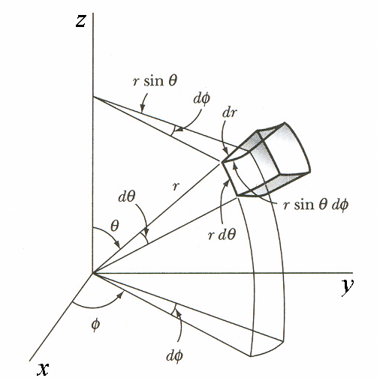
Spherical coordinates
$$dV=r^{2}\sin{θdrdθdφ}$$
$$dA=r^{2}\sin{θdθdφ}$$

Slide 24
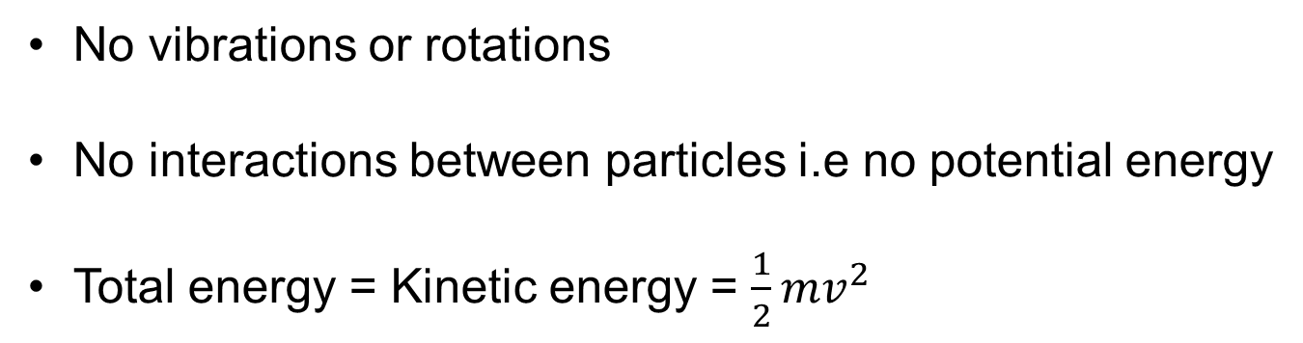
Monatomic ideal gas

Slide 26
First try to find the probability that the red particle has a certain velocity

Slide 28




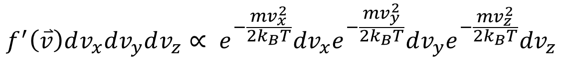
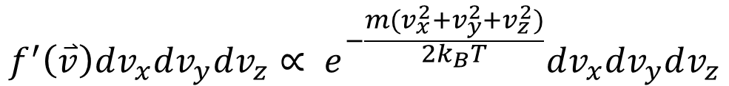
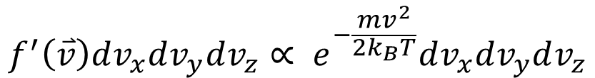

$$f^{′}\left(\overset{⃑}{v}\right)dv_{x}dv_{y}dv_{z}∝ e^{−\frac{mv^{2}}{2k_{B}T}}dv_{x}dv_{y}dv_{z}$$
$$f^{′}\left(\overset{⃑}{v}\right)dv_{x}dv_{y}dv_{z}∝ e^{−\frac{m(v_{x}^{2}+v_{y}^{2}+v_{z}^{2})}{2k_{B}T}}dv_{x}dv_{y}dv_{z}$$
$$f^{′}\left(\overset{⃑}{v}\right)dv_{x}dv_{y}dv_{z}∝ e^{−\frac{mv_{x}^{2}}{2k_{B}T}}dv_{x}e^{−\frac{mv_{y}^{2}}{2k_{B}T}}dv_{y}e^{−\frac{mv_{z}^{2}}{2k_{B}T}}dv_{z}$$
$$∝g\left(v_{x}\right)dv_{x}$$

Slide 29
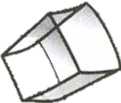
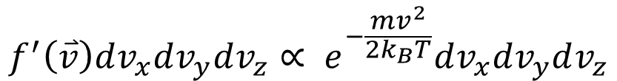



$$θ$$
$$\overset{⃑}{v}$$
$$φ$$
$$f^{′}\left(\overset{⃑}{v}\right)dv_{x}dv_{y}dv_{z}∝ e^{−\frac{mv^{2}}{2k_{B}T}}dv_{x}dv_{y}dv_{z}$$
$$f^{′}\left(\overset{⃑}{v}\right)v^{2}\sin{θ}dvdθdφ∝ e^{−\frac{mv^{2}}{2k_{B}T}}v^{2}\sin{θ}dvdθdφ$$

Slide 30
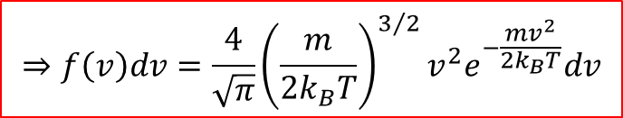
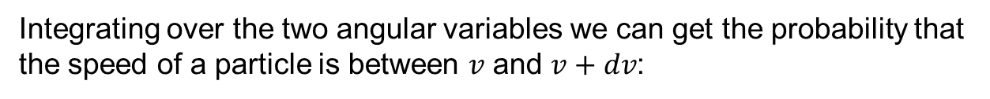

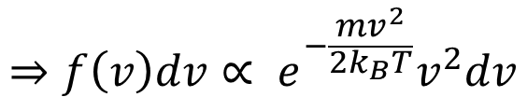
Integrating over the two angular variables we can get the probability that the speed of a particle is between $v$ and $v+dv$:
$$f^{′}\left(\overset{⃑}{v}\right)v^{2}\sin{θ}dvdθdφ∝ e^{−\frac{mv^{2}}{2k_{B}T}}v^{2}\sin{θ}dvdθdφ$$
$$⇒f\left(v\right)dv∝ e^{−\frac{mv^{2}}{2k_{B}T}}v^{2}dv$$
For $f\left(v\right)$ to be a proper probability distribution/density function:
$$\int_{0}^{∞}{f\left(v\right)dv}=1$$
$$⇒f\left(v\right)dv=\frac{4}{\sqrt{π}}{\left(\frac{m}{2k_{B}T}\right)}^{3/2}v^{2}e^{−\frac{mv^{2}}{2k_{B}T}}dv$$
Maxwell-Boltzmann speed distribution

Slide 31

T = 10
$$⇒f\left(v\right)dv=\frac{4}{\sqrt{π}}{\left(\frac{m}{2k_{B}T}\right)}^{3/2}v^{2}e^{−\frac{mv^{2}}{2k_{B}T}}dv$$
T = 1000
T = 100

Slide 32

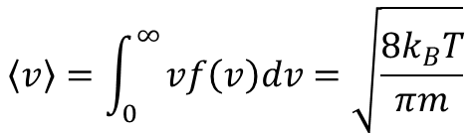
$$\left\langle v\right\rangle =\int_{0}^{∞}{vf\left(v\right)dv=\sqrt{\frac{8k_{B}T}{πm}}}$$
$$\left\langle v^{2}\right\rangle =\int_{0}^{∞}{v^{2}f\left(v\right)dv=\frac{3k_{B}T}{m}}=v_{rms}^{2}$$

Slide 33





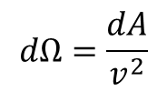

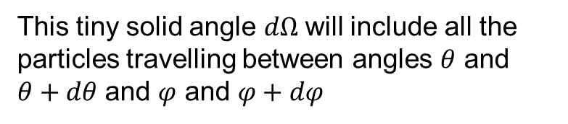

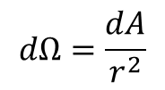
Solid angle $Ω=\frac{A}{r^{2}}$
In velocity space:
$$dΩ=\frac{dA}{r^{2}}$$
Or since its velocity space
$$v_{z}$$
$$dΩ=\frac{dA}{v^{2}}$$
$$θ$$
$$\overset{⃑}{v}$$
$$v_{y}$$
$$φ$$
This tiny solid angle $dΩ$ will include all the particles travelling between angles $θ$ and $θ+dθ$ and $φ$ and $φ+dφ$
$$v_{x}$$

Slide 34

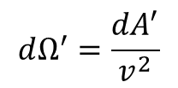
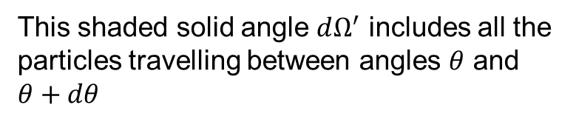
Solid angle $Ω=\frac{A}{r^{2}}$
In velocity space:
$$dΩ=\frac{dA}{r^{2}}$$
Or since its velocity space
$$v_{z}$$
$$dΩ^{′}=\frac{dA^{′}}{v^{2}}$$
$$dΩ=\frac{dA}{v^{2}}$$
$$θ$$
$$dA^{′}=2πv^{2}\sin{θdθ}$$
$$\overset{⃑}{v}$$
$$v_{y}$$
$$φ$$
This shaded solid angle $dΩ^{′}$ includes all the particles travelling between angles $θ$ and $θ+dθ$
$$v_{x}$$

Slide 35


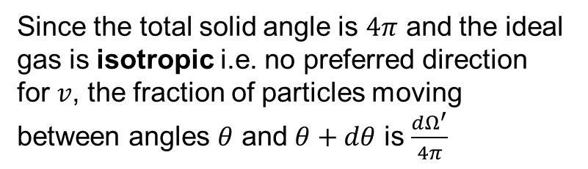
Solid angle $Ω=\frac{A}{r^{2}}$
In velocity space:
$$dΩ=\frac{dA}{r^{2}}$$
Or since its velocity space
$$v_{z}$$
$$dΩ^{′}=\frac{dA^{′}}{v^{2}}$$
$$dΩ=\frac{dA}{v^{2}}$$
$$dA^{′}=2πv^{2}\sin{θdθ}$$
$$θ$$
$$⇒dΩ^{′}=2π\sin{θdθ}$$
$$\overset{⃑}{v}$$
$$v_{y}$$
$$φ$$
Since the total solid angle is $4π$ and the ideal gas is isotropic i.e. no preferred direction for $v$, the fraction of particles moving between angles $θ$ and $θ+dθ$ is $\frac{dΩ^{′}}{4π}$
$$v_{x}$$

Slide 36
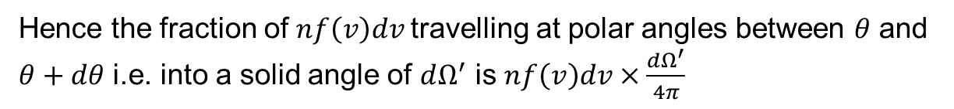


Once again:
Probability that a particle in a monatomic ideal gas has a speed between $v$ and $v+dv$ is given by:
$$⇒f\left(v\right)dv=\frac{4}{\sqrt{π}}{\left(\frac{m}{2k_{B}T}\right)}^{3/2}v^{2}e^{−\frac{mv^{2}}{2k_{B}T}}dv$$
If the total number of particles is $N$ then the number per unit volume is $n=\frac{N}{V}$
Therefore, the number per unit volume in a monatomic ideal which have speeds between $v$ and $v+dv$ is
$$nf\left(v\right)dv$$
These particles are travelling in all possible directions i.e. the entire $4π$ steradians of solid angle.
Hence the fraction of $nf\left(v\right)dv$travelling at polar angles between $θ$ and $θ+dθ$ i.e. into a solid angle of $dΩ^{′}$ is $nf\left(v\right)dv×\frac{dΩ^{′}}{4π}$

Slide 37
The number per unit volume in a monatomic ideal which have speeds between $v$ and $v+dv$ and travelling at polar angles between $θ$ and $θ+dθ$ is:
$$dn^{′}=nf\left(v\right)dv\frac{dΩ^{′}}{4π}=nf\left(v\right)dv\frac{2π\sin{θdθ}}{4π}=nf\left(v\right)dv\frac{1}{2}\sin{θdθ}$$
$$v_{z}$$
$$θ$$
$$\overset{⃑}{v}$$
$$v_{y}$$
$$φ$$
$$v_{x}$$
Remember all this is happening in velocity space

Slide 38


















This is what happens in real space
θ
$$v_{z}$$
$$v_{z}$$
$$θ$$
A
$$v_{z}$$
$$\overset{⃑}{v}$$
$$v_{y}$$
$$θ$$
$$φ$$
$$\overset{⃑}{v}$$
$$θ$$
$$\overset{⃑}{v}$$
$$v_{y}$$
$$v_{x}$$
$$φ$$
$$v_{y}$$
$$φ$$
$$v_{x}$$
vdt
$$v_{x}$$

Slide 39

θ
A
$$dV=Avdt\cos{θ}$$
vdt

Slide 40

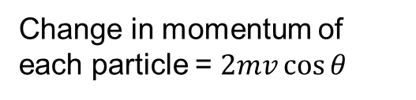

The number of particles which have speeds between $v$ and $v+dv$ and travelling at polar angles between $θ$ and $θ+dθ$ and hitting the wall of area $A$ in time $dt$:
$$dN=dn^{′}dV=nf\left(v\right)dv\frac{1}{2}\sin{θdθAvdt\cos{θ}}$$
Change in momentum of each particle = $2mv\cos{θ}$
$$θ$$

Slide 41

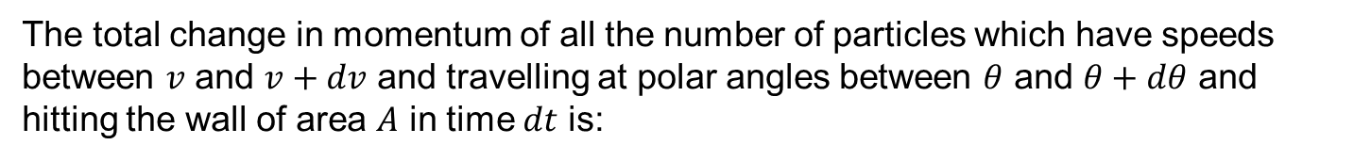
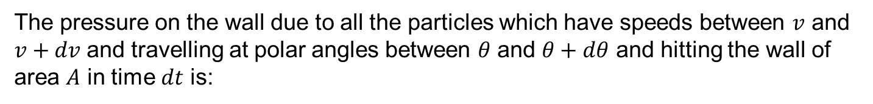

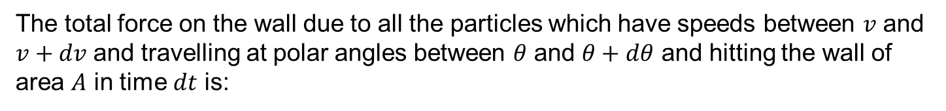
The total change in momentum of all the number of particles which have speeds between $v$ and $v+dv$ and travelling at polar angles between $θ$ and $θ+dθ$ and hitting the wall of area $A$ in time $dt$ is:
$$d\tilde{p}=dN×2mv\cos{θ}=nf\left(v\right)dv\frac{1}{2}\sin{θdθAvdt\cos{θ}×}2mv\cos{θ}$$
The total force on the wall due to all the particles which have speeds between $v$ and $v+dv$ and travelling at polar angles between $θ$ and $θ+dθ$ and hitting the wall of area $A$ in time $dt$ is:
$$dF=\frac{d\tilde{p}}{dt}=nf\left(v\right)dv\frac{1}{2}\sin{θdθAv\cos{θ}×}2mv\cos{θ}$$
The pressure on the wall due to all the particles which have speeds between $v$ and $v+dv$ and travelling at polar angles between $θ$ and $θ+dθ$ and hitting the wall of area $A$ in time $dt$ is:
$$dp=\frac{dF}{A}=nf\left(v\right)dv\frac{1}{2}\sin{θdθv\cos{θ}×}2mv\cos{θ}$$

Slide 42
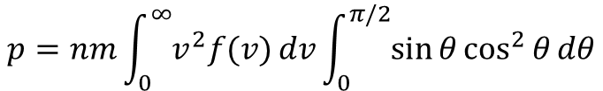





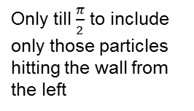
$$⇒dp=n{mv}^{2}f\left(v\right)dv\sin{θ}\cos^{2}{θ}{dθ}$$
The pressure on the wall due to all the particles in the gas is:
Only till $\frac{π}{2}$ to include only those particles hitting the wall from the left
$$p=nm\int_{0}^{∞}{v^{2}f(v)}dv\int_{0}^{π/2}{\sin{θ}\cos^{2}{θ}{dθ}}$$
$$=nm\left\langle v^{2}\right\rangle \frac{1}{3}$$
$$=nm\frac{3k_{B}T}{m}\frac{1}{3}$$
$$=nk_{B}T=\frac{N}{V}k_{B}T$$
$$⇒pV=Nk_{B}T$$

Slide 43













$$c$$
$$A_{2}$$
$$A^{′}$$
$$b$$
$$A_{2}$$
$$A_{1}$$
$$A$$
$$θ$$
$$\frac{π}{2}−θ$$
$$θ$$
$$b$$
$$c$$
$$a$$
$$A^{′}=A_{1}+2A_{2}=(b\cos{θ)(c−b\sin{θ)+2∙\frac{1}{2}∙b\sin{θ∙b\cos{θ}}}}=bc\cos{θ}$$
$$V=a∙A^{′}=abc\cos{θ}=Ac\cos{θ}$$

Slide 44




$$b$$
$$c$$
$$a$$
$$V=\vec{a}∙\vec{b}×\vec{c}$$

