Slide 1
Liquefying a gas by applying pressure
P
v
T

Slide 2
Liquefying a gas by applying pressure
P
v
T

Slide 3
Liquefying a gas by applying pressure
P
v
T

Slide 4
Liquefying a gas by applying pressure
P
v
T

Slide 5
Liquefying a gas by applying pressure
P
v
T

Slide 6
Liquefying a gas by applying pressure
P
v
T

Slide 7
Liquefying a gas by applying pressure
P
v
T

Slide 8
$$={(dG)}_{T,p}=\sum{μ_{i}dn_{i}}+γdA$$
vapor
$$⇒dG=μ_{liq}dn_{liq}+μ_{vap}dn_{vap}+γdA$$
$$dn_{liq}+dn_{vap}=0$$
$$r$$
$$⇒dG=(μ_{liq}−μ_{vap})dn_{liq}+γdA$$
$$r+dr$$
liquid
$$⇒dG=−∆μdn_{liq}+γdA$$
$$dA=8πrdr$$
$$ρ_{liq}=\frac{M_{liq}}{V_{liq}}=\frac{{mn}_{liq}}{V_{liq}}=\frac{{mn}_{liq}}{\frac{4}{3}πr^{3}}$$
$$⇒dn_{liq}=4πr^{2}dr\frac{ρ_{liq}}{m}$$
$$⇒dG=−∆μ4πr^{2}dr\frac{ρ_{liq}}{m}+γ8πrdr$$
$$⇒G=−∆μ\frac{ρ_{liq}}{m}\frac{4}{3}πr^{3}+γ4πr^{2}+G(0)$$

Slide 9
$$⇒G=−∆μ\frac{ρ_{liq}}{m}\frac{4}{3}πr^{3}+γ4πr^{2}+G(0)$$
$$G$$
$$r_{c}$$
$$r$$
$$⇒dG=−∆μ4πr^{2}dr\frac{ρ_{liq}}{m}+γ8πrdr=0⇒r_{c}=\frac{2γm}{∆μρ_{liq}}$$

Slide 10
Homogeneous nucleation and growth
Thermal hysteresis in first order transitions

Slide 11
Nucleation and growth with disorder

Slide 12
Solid-Solid first order transition
Long range strain interactions
(Include elastic energy due to different structures)
Ahn et al., Nature 428, 401 (2004)

Slide 13
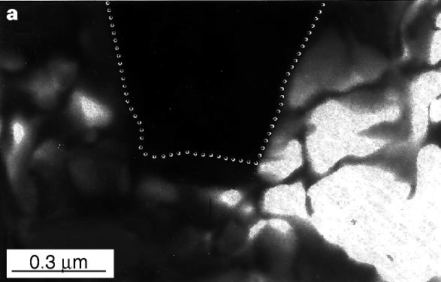
Micrometer-scale phase separation
FMM
COI
Uehara et al., Nature 399, 560 (1999)
Notes:
One of the interesting pheonomena in manganites is the larger scale phase separation. One way is to mix ferromagnetic and metallic LCMO and antiferromagnetic and insulating PCMO. We mixed this two, while we keep carrier concentration. This material is called LPCMO, which I will discuss on today.
When you mixed those, you expect there is internal strains and disorders are created. This causes unusual micrometer scale phase separation. Unlike LCMO, this system has AFM phase and FM phase. Each phase are coupled to different electronic phases. It creates first order like transition in transport measurements.
Free energy between AFM and FM phase are similar.
In cooling, their free energies are similar near insulator-transition temperature.

Slide 14
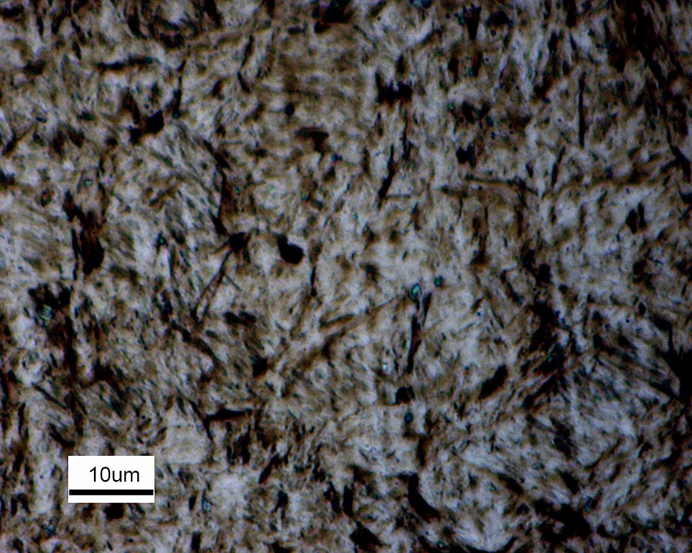

Slide 15
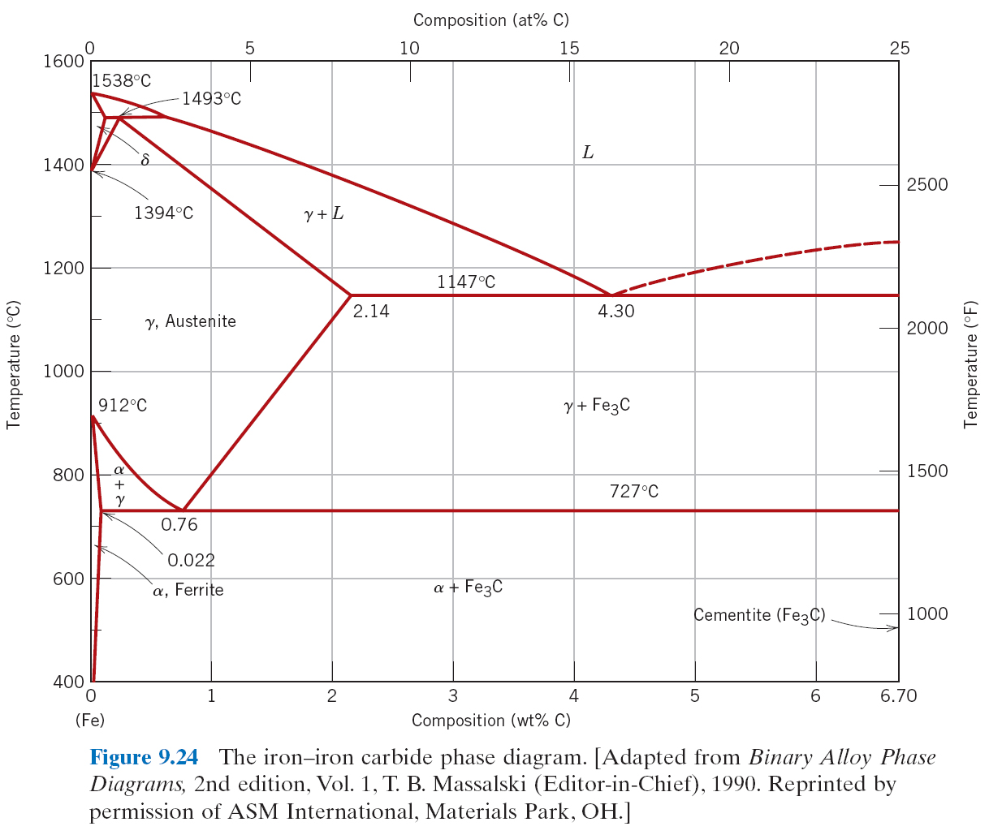

Slide 16
