Slide 1



HIGH B/T FACILITY
Users Committee Meeting, October 2017 (Gainesville, FL)
CHAO HUAN
Breakout Session

Slide 2


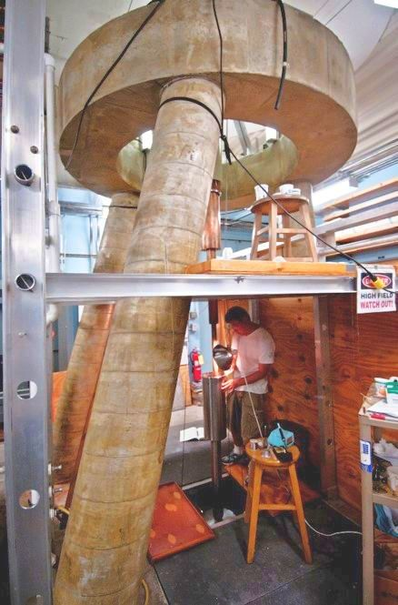

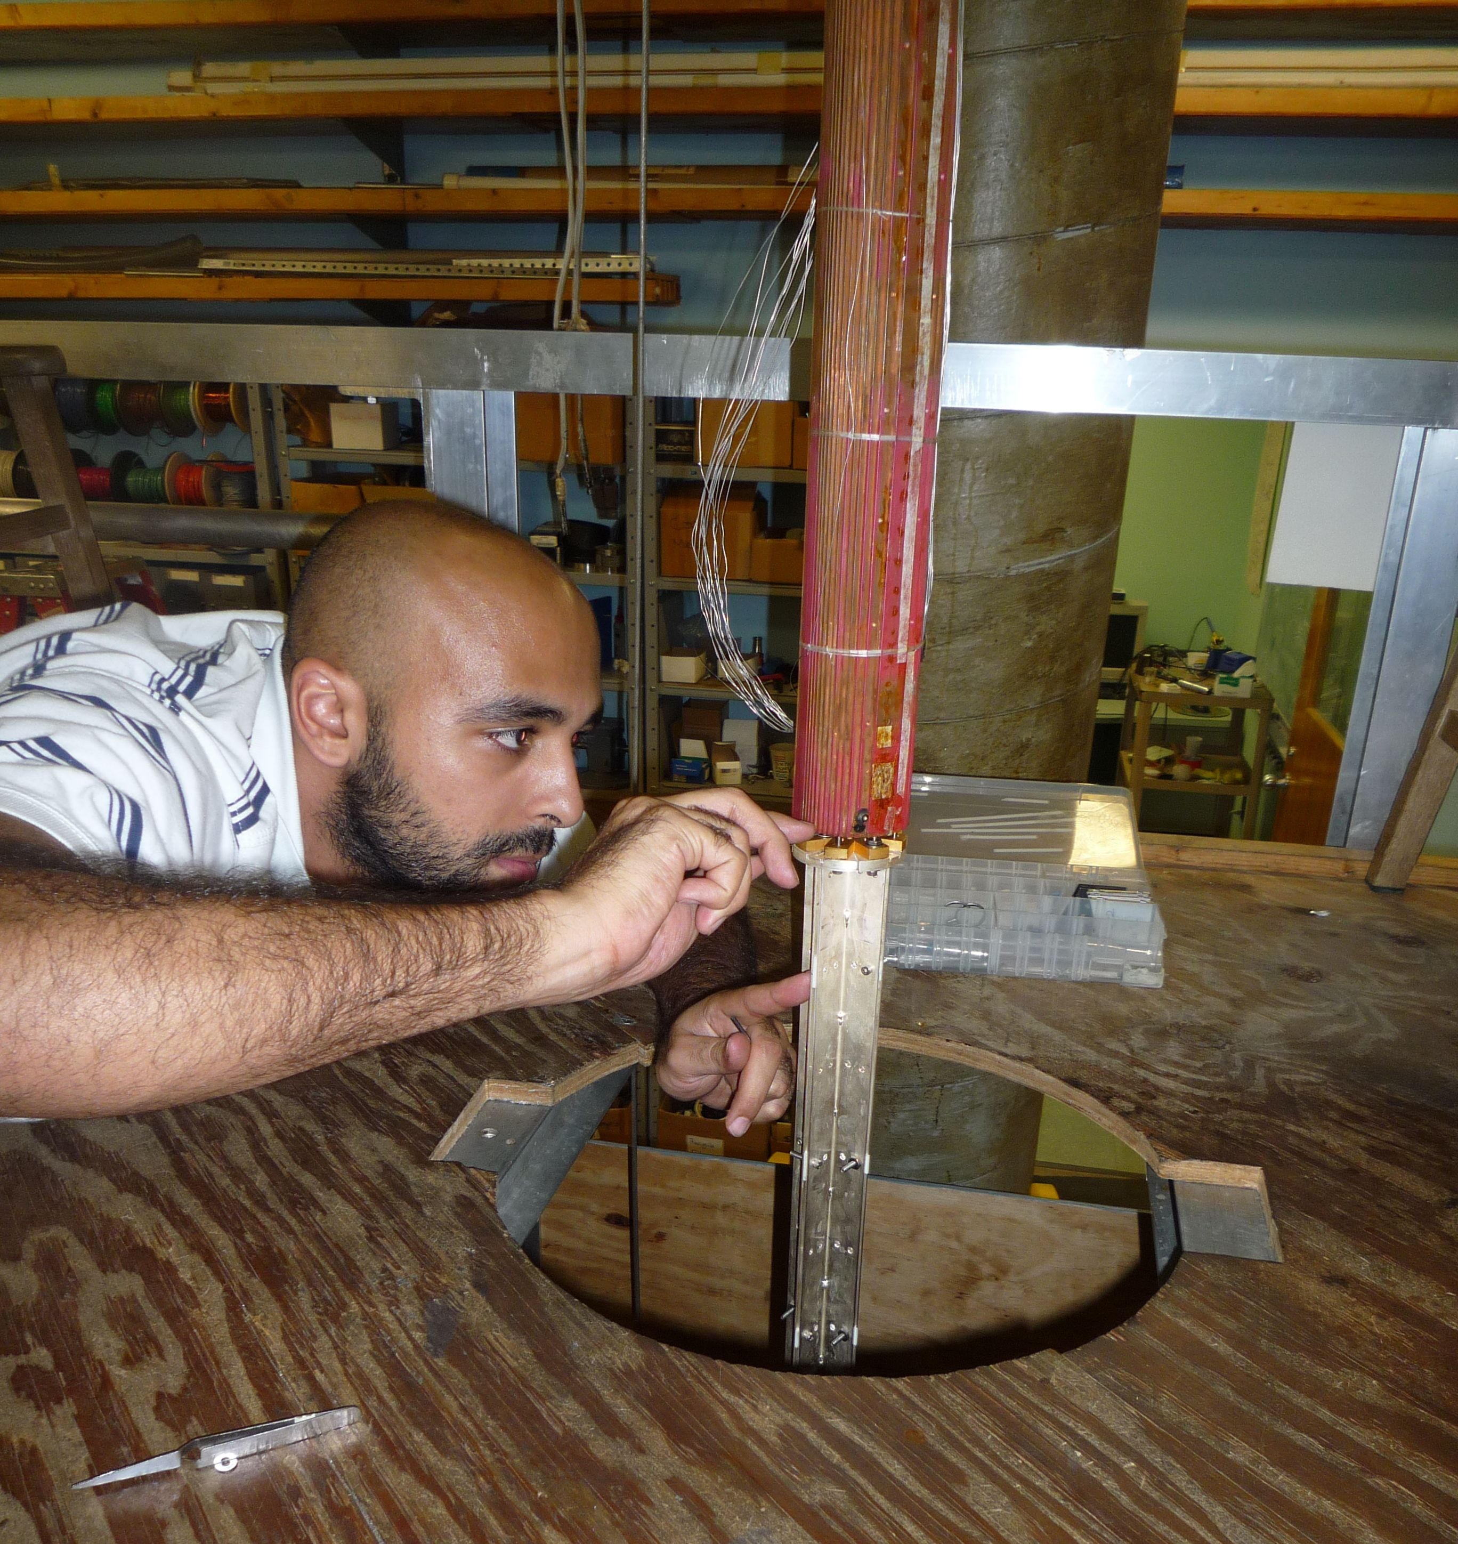
HIGH B/T Mission
Research at high magnetic fields and ultra-low temperatures
UNIQUE Combination of cooling power (~ 10 nW)
and ultra-quiet environment
  Nuclear demagnetization refrigerators
  Dilution refrigerators
  Vibration isolation, EM shielding
Fundamental research into properties of materials at the extremes of parameter space (magnetic field, temperature)
  Frustrated magnet systems
  Exotic quantum Hall states at mK to sub-mK
  1D quantum fluids 3He …. Luttinger liquid (no charge)
Users want reduced queue time & higher magnetic fields
Renewal Proposal: Open Bay 1

Slide 3
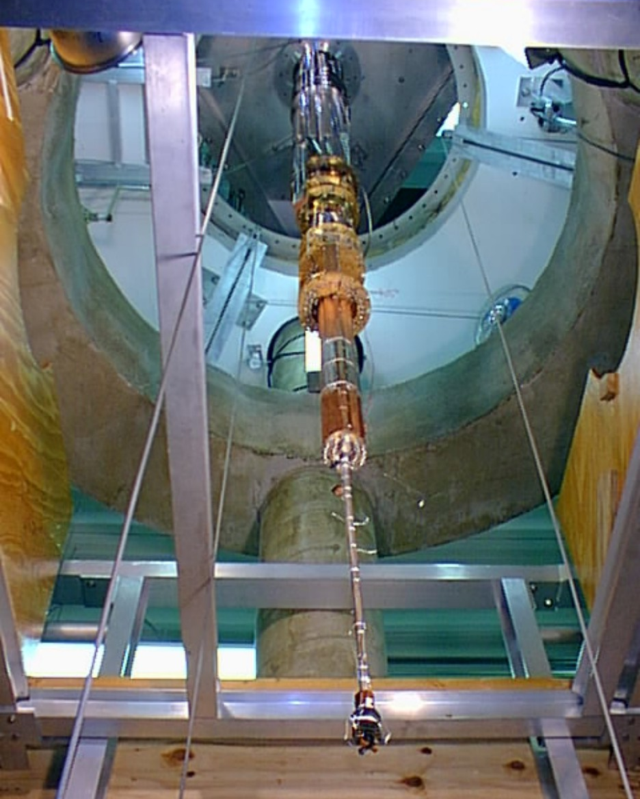
HIGH B/T FACILITY AND EXPERIMENTS
MAGNETIC AND CRYOGENIC CAPABILITIES
Unique Advantages
Specialized Instruments
REVIEW OF EXPERIMENTS
Two Dimensional Electron Gases
BEC and Quantum Magnetism
Liquid and Solid Helium
FUTRUE DEVELOPMENT
20 T and up

Slide 4
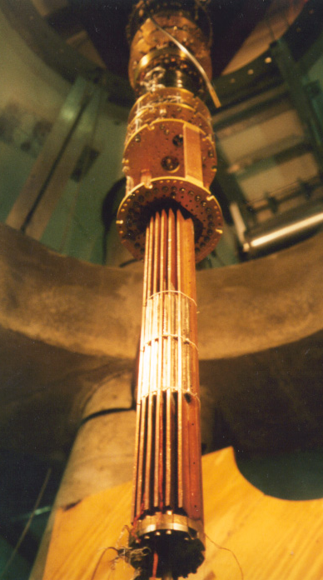
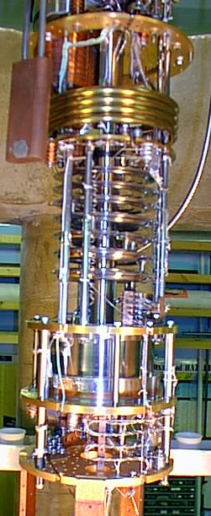
UNIQUE ADVANTAGES
Powerful nuclear stage
ULTRA-LOW EMPERATURES WITH LARGE COOLING POWER
Dilution refrigerator:
Base temperature ~ 7 mK
700 μW @ 100 mK
5 moles PrNi₅ +
45 moles Pure Cu

Slide 5
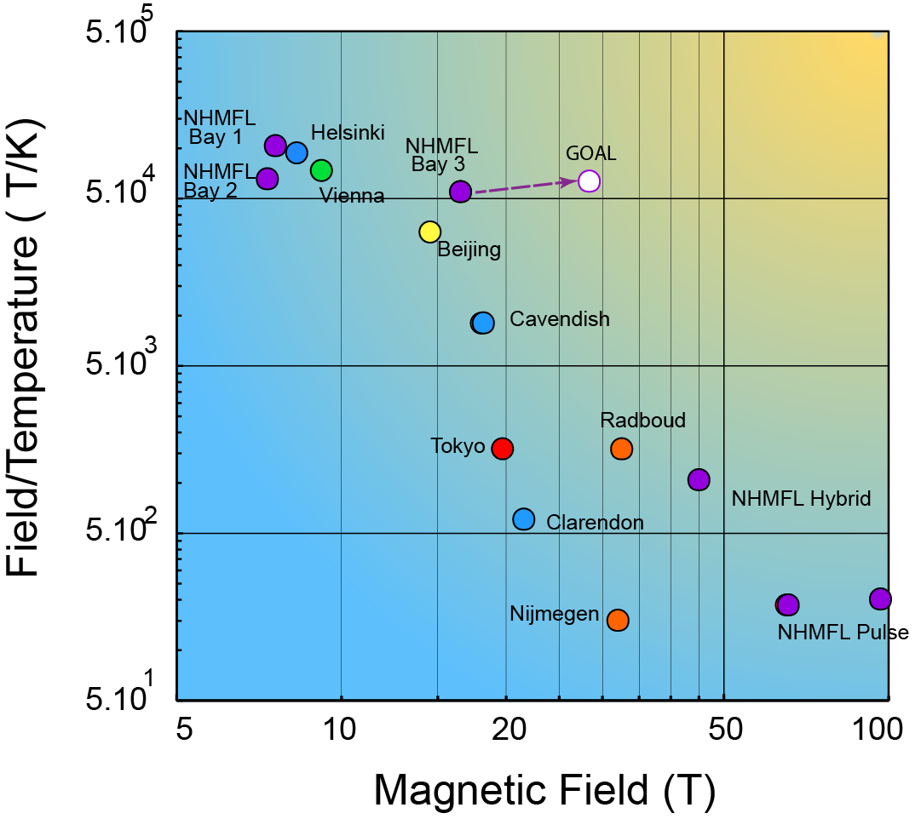
Competitive Facilities
(not all serve external users)
--- a few have nuclear demagnetization stages
----- but only small residual magnetic field

Slide 6
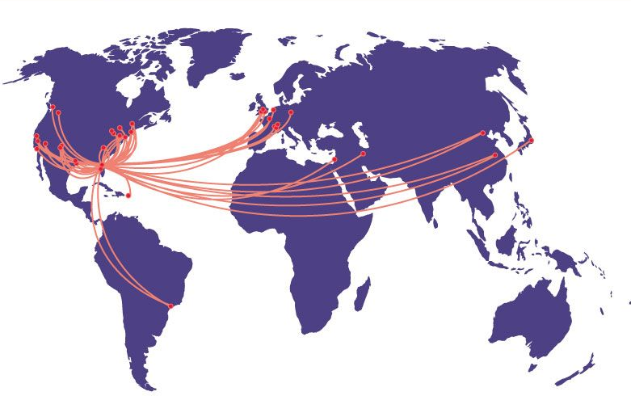
HIGH B/T FACILITY AND USERS
39 % users
International

Slide 7
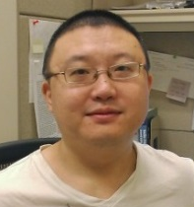

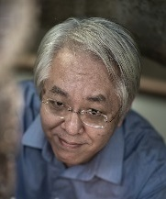
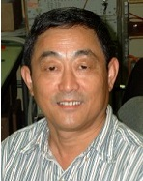
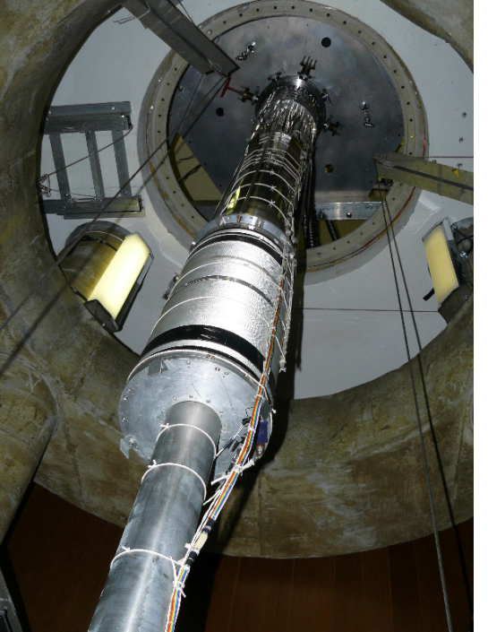
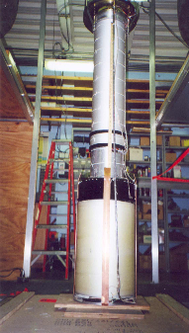
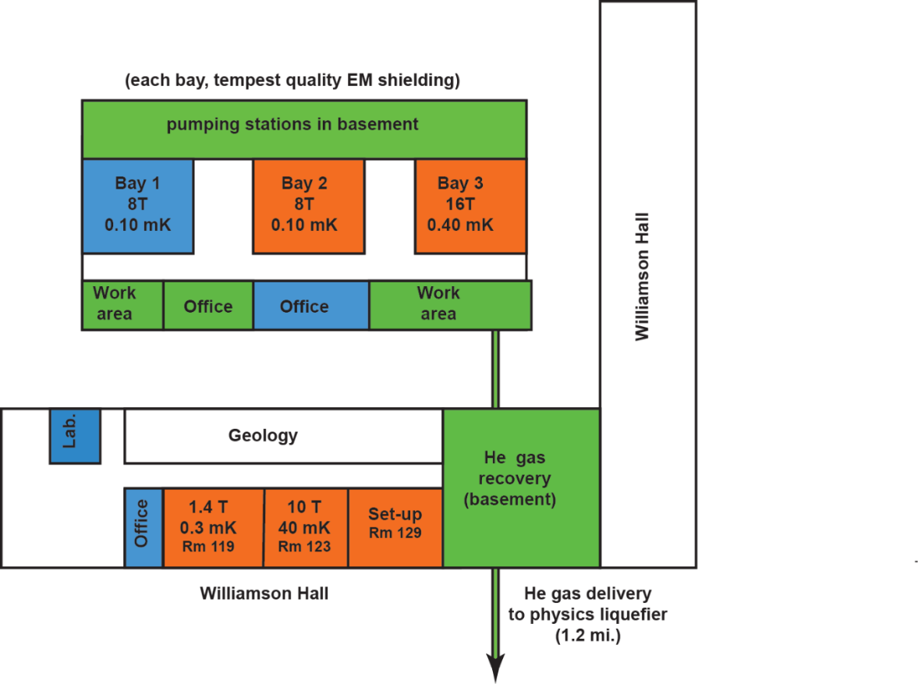
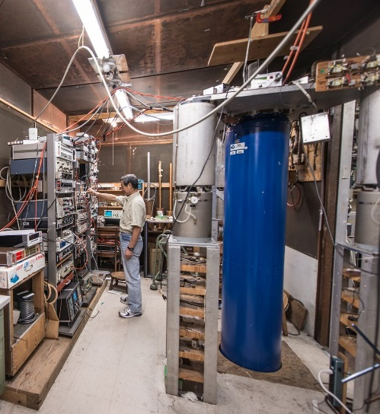
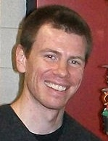
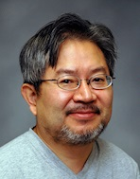


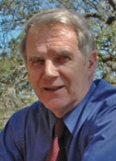
High B/T Facility
staff
Three nuclear demagnetization refrigerators.
copper nuclear refrigerators
(0.1 milliKelvin)
PrNi₅ demagnetization
refrigerator
(0.4 milliKelvin)
3-stage magnet
for bay 3
Fast turn-around
(10 Tesla, 40 milliKelvin)
research
faculty
Notes:
Search for new additional faculty member in progress

Slide 8
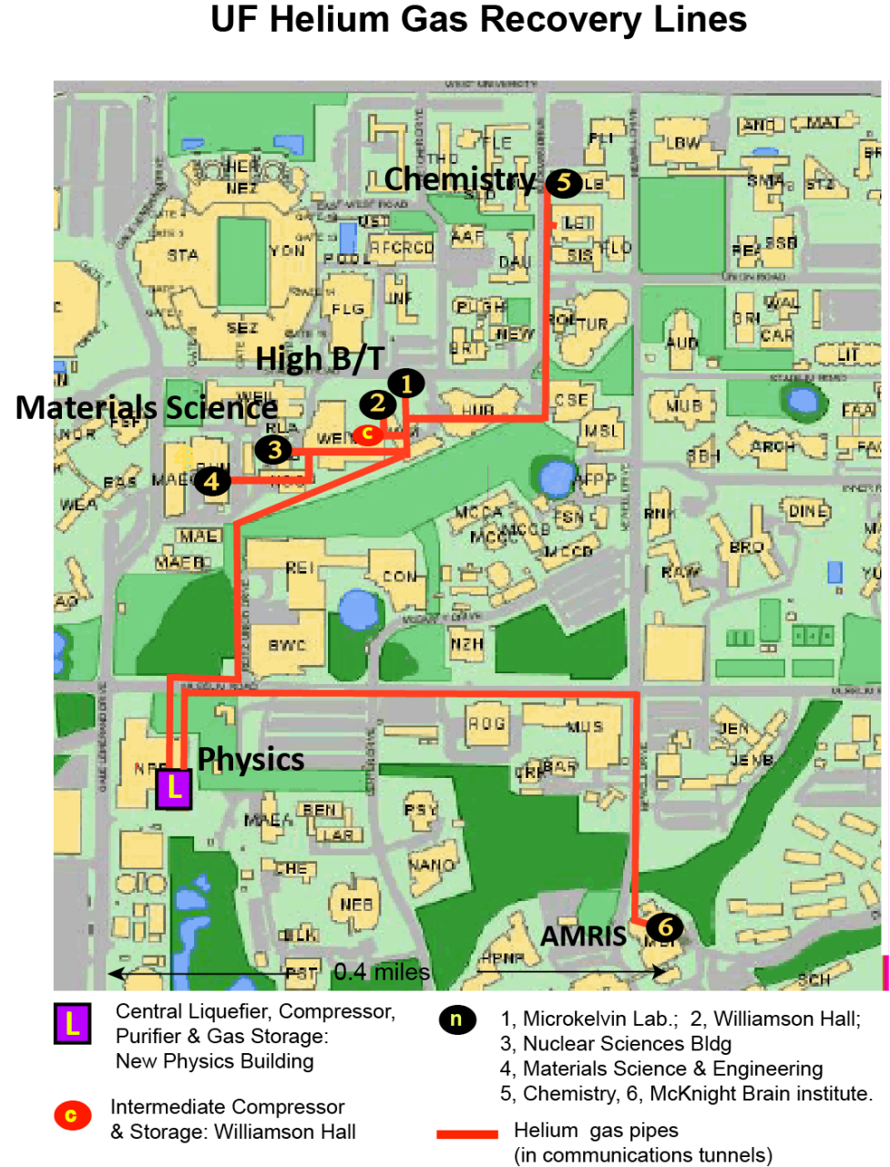
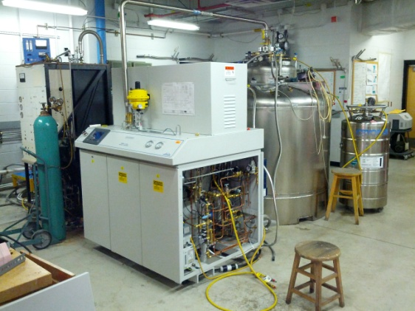

UF Campus-wide Helium Recovery System
New liquefier installation (NSF ARIR2 award)
serves High B/T, and AMRIS plus Physics, Chem. & Mat. Sci.
Unique monitoring – Nature, Sept. 2013.

Slide 9
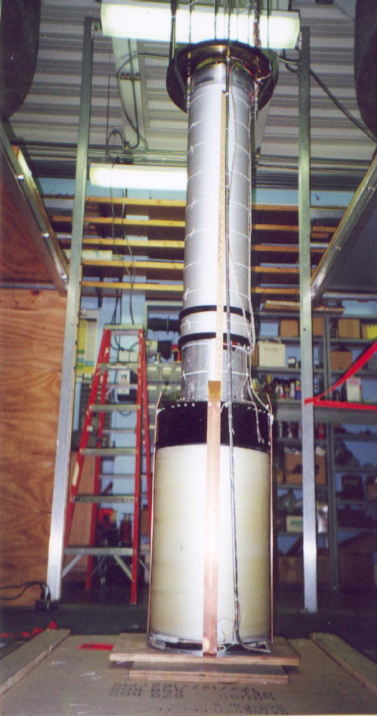
Bay 3 Magnet System:
2 Magnets +Compensation Coil
PrNi5 ~ 10 nW cooling power
Compensation coils
16.5 T (current max.)
Designed as an integral system

Slide 10
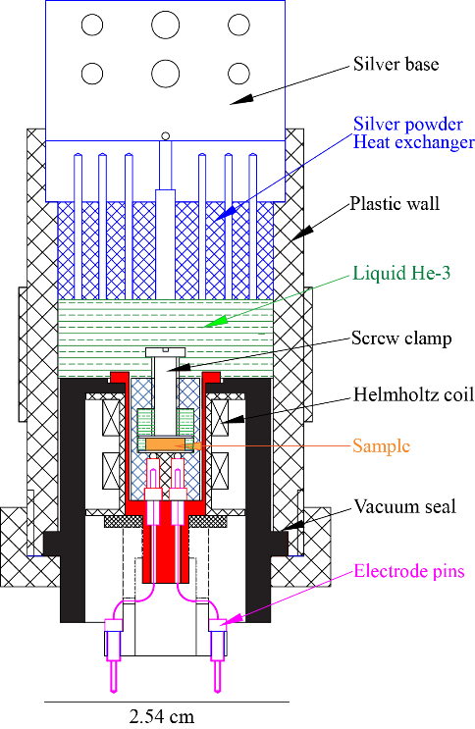
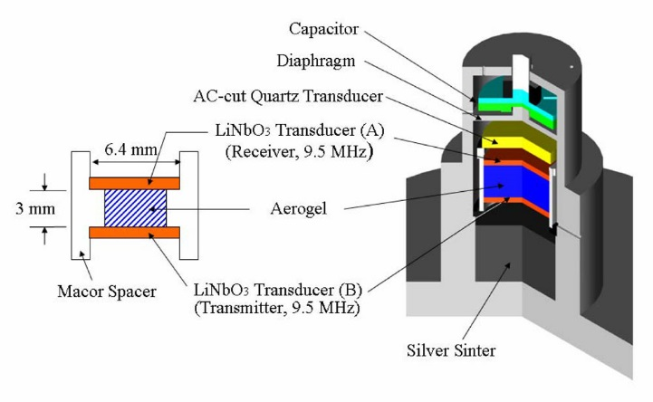
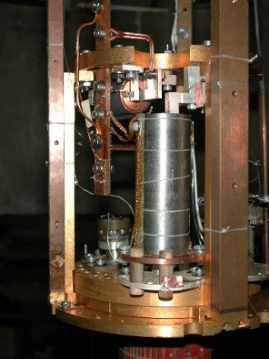
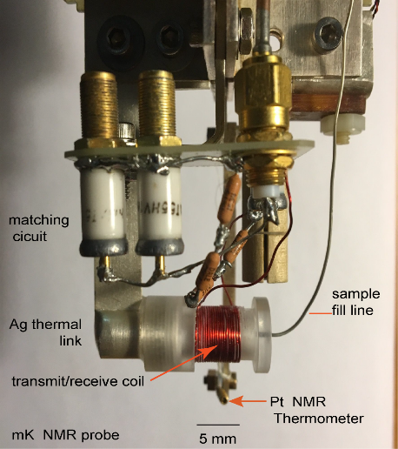
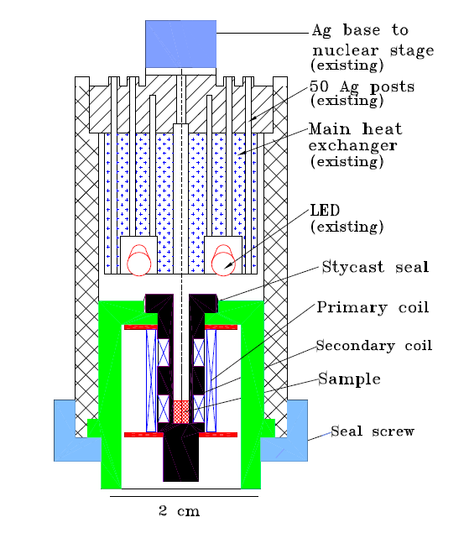
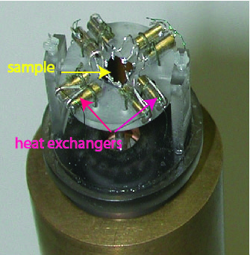
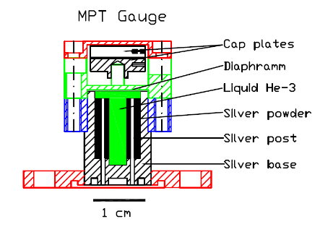
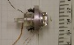
Specialized Instrumentation for Low T, High B
Pt NMR thermometer (above demag.)
Ultrasound studies (superfluid ³He)
Users: Lee, Meisel, Masuhara
High sensitivity dielectric
measurements
(magneto-electric effect
DTN, PbCrO₃)
Users: Wang, Chan
Ultra-low Temperature Rotator quantum Hall studies
Users: Xia, Pan, Tsui..
High Sensitivity NMR
Diffusion liquid ³He:
Users: Curro, Candela…
Sub-mK susceptibility studies
QPTs: Users: Zapf, Sun, Yin
³He melting
pressure
thermometer

Slide 11
High B/T Facility
Growth 2006-2015
helium costs(units$2.5k)
funding (unit $25k)
Typical experiment:
1 PI
2.5 Co-PIs
1 local collaborator
1 sample maker
1 sample characterization
0.5 postdoctoral fellow
0.5 graduate student.
Uses 3000-6000 liters of liquid He
Fabrication of sample mount, testing lasts
2-9 months (varies widely)
open Bay 2
publications
Research areas

Slide 12
User Feedback Comments (2014-2015)
Formal Comments
“Please let me express my sincere appreciation for your support and help for our experiment in High B/T Facility in the University of Florida this summer. The equipment I used was in great condition. Dr. Xia, Dr. Meisel and Dr. Sullivan were very helpful. The Stanford SR830 Lock-in Amplifiers I used were brand new and in excellent condition.”
2. “I completed safety training before I came to UF and had no safety concerns or questions. Dr. Xia talked to me about safety at the beginning and end of experiment.
3. “Let me express my gratitude for giving us experimental time at the high B/T facility. It was a very educational experience. I was informed about many new techniques and apparatus designs which we plan to deploy here in our lab in Stuttgart.”
Informal Comments
“Parking space is needed” for long term users of the High B/T facility. (perennial)
Recommend users reserve at Reitz Union (very close, [safety] & free parking)
2. “Can we do experiments at low field to access ultra-low temperature capability not available elsewhere?”

Slide 13
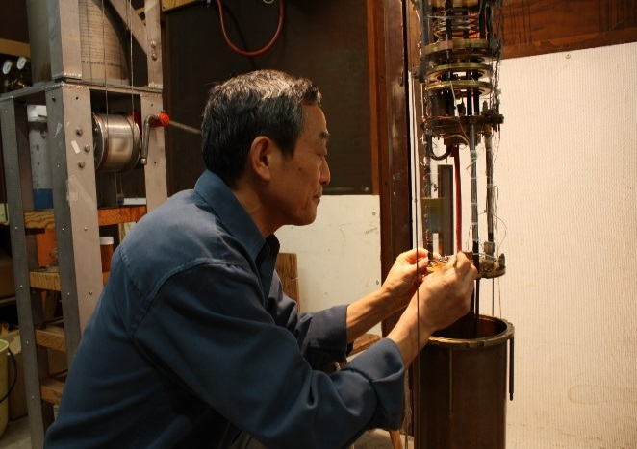
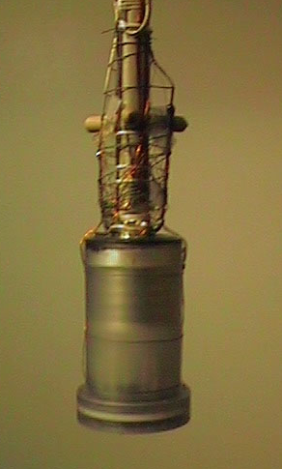
High B/T Procedures
Users review proposed experiment with staff (needs, cell design….)
Proposal submission anytime throughout year
II. External review of proposal ~ month
III. Internal review (feasibility, ULT needs) – UF LT faculty
Approve/Disapprove. Assign magnet time
(new PI, young investigator can jump queue)
Design & construct experimental cell (staff intensive – bottleneck)
All On-Site Users take on-line safety training on main NHMFL website
Typical Year
0-2 new users
6-7 proposed experiments
0-2 rejected proposals
Operate 24/7 10-11 months
1-2 experiments fail (sample, cell leaks….)

Slide 14



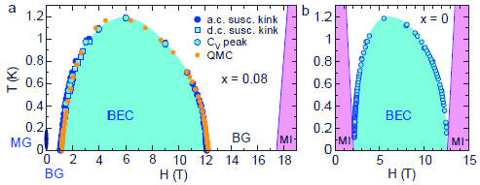
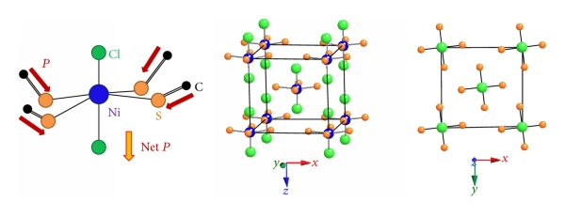
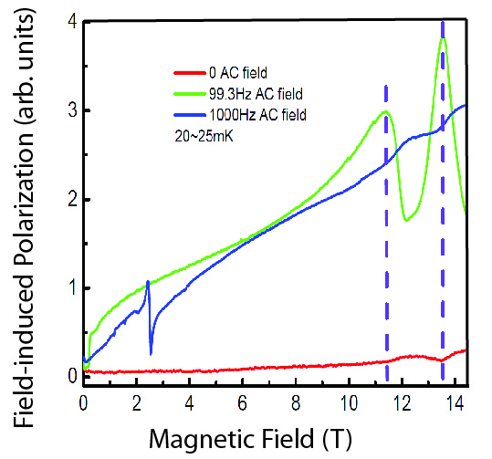


Magnetic Field Induced Polarization in Bose Glass State
Armando Paduan Filho (Sao-Paulo, Brazil), Vivien Zapf (Los Alamos),
Jian-sheng Xia, Liang Yin (Univ. Florida)
Bose Glass State – Introduce disorder to BEC
Quantum organic magnet:
Dichloro-tetrakis-thiourea-nickel , or DTN.
magnon quasiparticles (Ni spins) undergo BEC.
Disorder intro. in controlled manner (Br doping)
Bose-Glass (BG) state
Magneto-electric Effects – orientation of polar
thiourea molecules in spin ordered states
“glassy” nature of the BG state
induced polarization dependent on frequency of excitation.
Unique high sensitivity ultra-low T dielectric cells
to measure polarization of doped DTN (15% Br)
Ref. : R. Yu et al, Nature 489 (7416), 379-384 (2013).
Low temperature phase diagrams for (a) BEC condensed DTN,
(b) Bose glass state in Br-doped (15%) DTN
NHMFL High B/T Facility
Bay 3 of the Microkelvin Laboratory
Crystal structure :
Ni spins blue,
Cl separators green
I. strong frequency dependent induced polarization
II. clear indications of the transitions: BG state to BEC phase

Slide 15


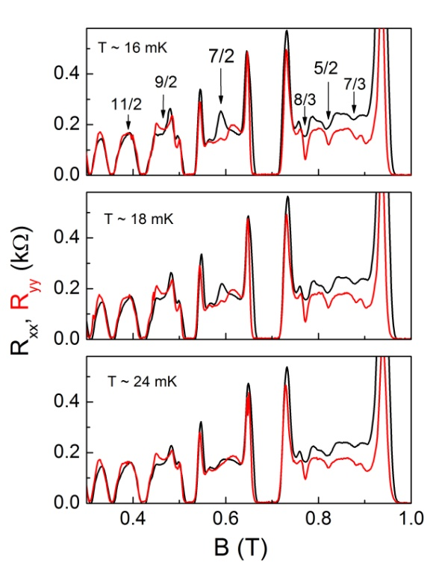
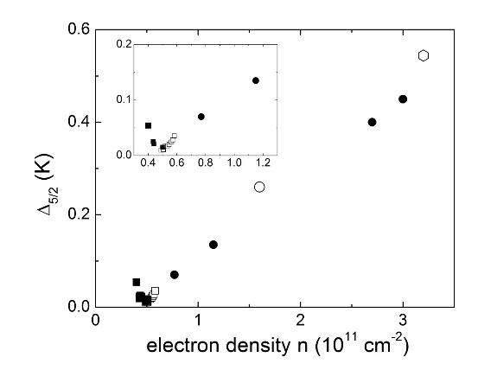
Competing Quantum Hall Phases: Second Landau Level of
2D Electron Systems
W. Pan (Sandia Nat Lab.), D. Tsui, K. W. Baldwin, K. W. West, L. N. Pfeiffer (Princeton Univ.)
Quantum Hall Effect in Second Landau Level
Recent progress in fabrication of high-quality low-density samples allows one to probe exotic quantum Hall states such as the n =5/2 and 7/2 states a new regime where the electron-electron interactions are strong.
New Low Temperature Results
First observation of anisotropic transport for ν = 7/2 in a high-quality dilute (n=5x10¹⁰ cm⁻² ) 2D electron system.
New behavior attributed to a large Landau level mixing effect that perturbs the pairing stability of composite limit.
upturn in the energy gap for n < 5x10¹⁰ cm⁻²
implies spin unpolarized ground state
Competing quantum Hall phases in the second Landau level in the low-density limit
Ref. W. Pan et al., Phys. Rev. B 89, 241302(R) (2014).
NHMFL High B/T Facility
Bay 2 of the Microkelvin Laboratory

Slide 16

Pinning and melting of a quantum Wigner crystal
T. Knighton, Z. Wu, J. Huang (Wayne State Univ.) A. Serafin, J.-S. Xia (NHMFL), K.W. Baldwin, K.W. West, L.N. Pfeiffer (Princeton Univ.)
Quantum Wigner Crystals
Seek unambiguous demonstration of crystallization to an electron solid state.
For two-dimensional electron systems, the competing kinetic energy is quenched by application of a perpendicular magnetic field. This leads to new reentrant insulating phases (RIP).
Very-Low Temperature Results
Studied high mobility (m = 3.0 × 10⁶cm²/Vs),
for 20nm GaAs/AlGaAs/GaAs square well.
Observe striking threshold behavior T < 30 mK. Holes are pinned within a narrow range of ±5 pA (resistance > 1 GΩ). Just above Tc
the resistance plummets by ~ 3 orders of magnitude. Pinning is also
destroyed by heating consistent with a melting transition.
Temperature dependence is non-activated existence of a pinned WC appears to undergo a second-order transition upon heating,
in agreement with theory.
Quantum Hall effect in GaAs heterostructure showing
(a) RIP phase;
(b) Small signal IV characteristics
NHMFL High B/T Facility
Bay 3 of the Microkelvin Laboratory

Slide 17


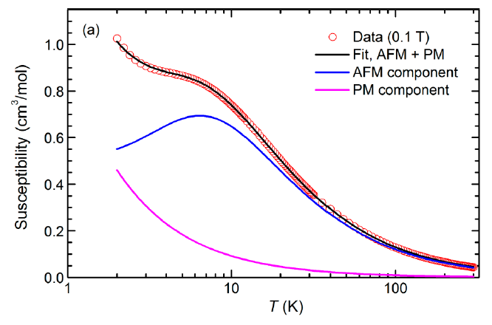
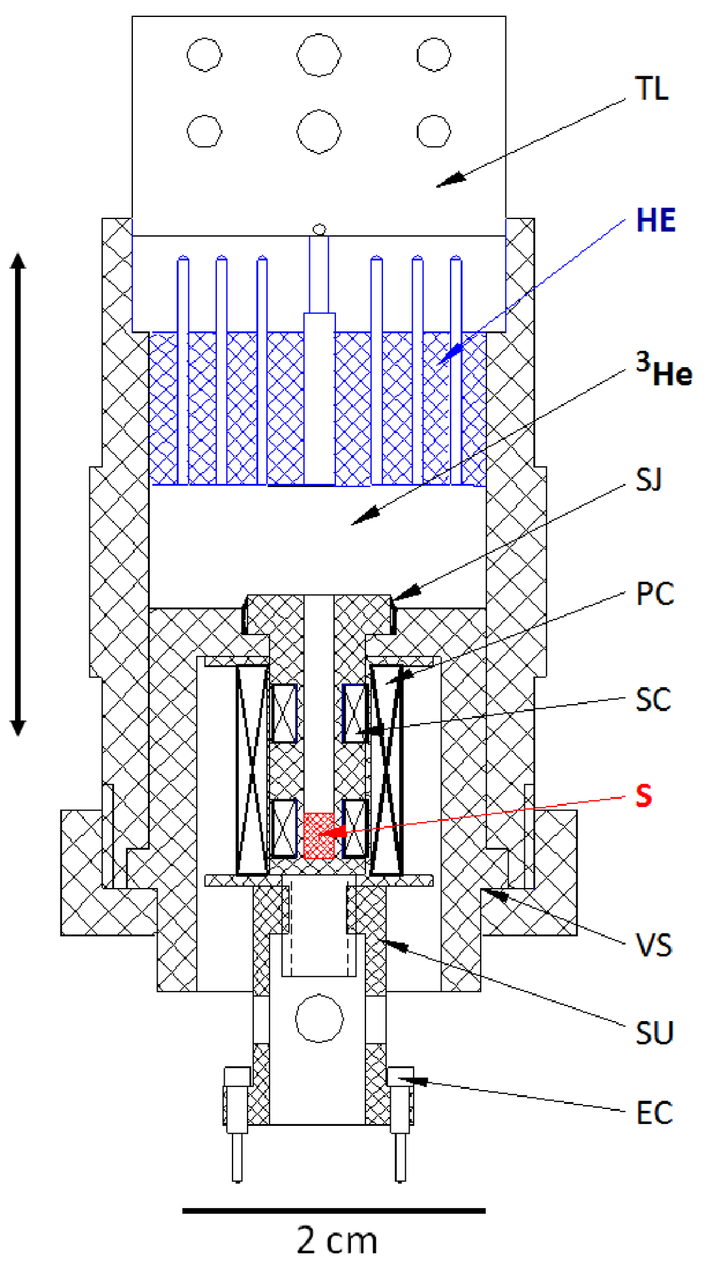
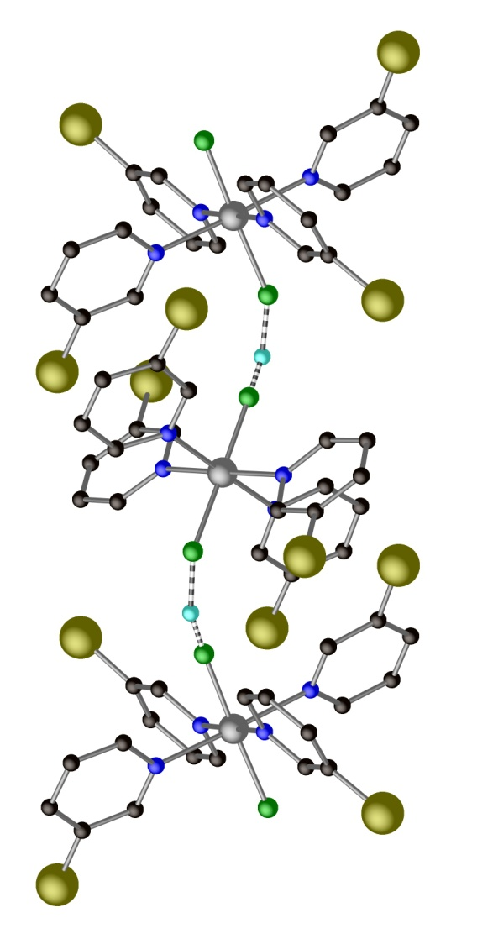
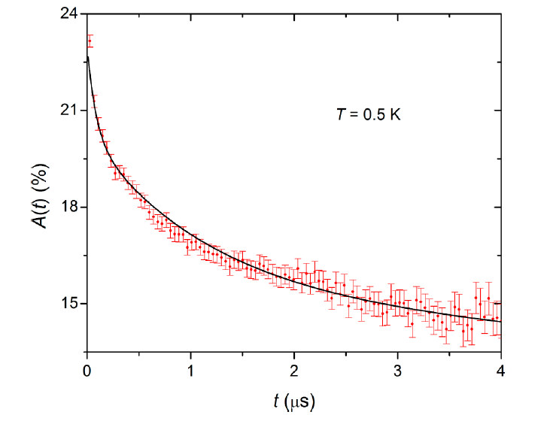

Unusual Magnetic Response an S = 1 Antiferromagnetic Linear-Chain Material:
[Ni(HF₂)(3-Clpy)₄]BF₄ (known as NBCT)
J.L. Manson, P.M. Spurgeon, A.G. Graham (Chem@Eastern Washington Univ),
J.-S. Xia and M.W. Meisel (MagLab@UF) and A. Ozarowski (MagLab@EMR)
[Ni(HF₂)(3-Clpy)₄]BF₄ – J.L.Manson et al., Inorg. Chem. 51 (2012) 7520 [1]
J.S. Xia et al., J. Phys. Conf. Ser. (LT28) in press (2017)
3-Clpyridine = C₅H₄ClN
“zig-zag”
chain
50 - 400 mK
500 mK
600 mK
800 mK
1000 mK
F
Ni (S = 1)
F
H
F
Ni (S = 1)
F
H
F
Ni (S = 1)
F
J = 4.86 K
g = 2.10
Zero-field μ⁺SR at T = 0.5 K and same type of spectra at T = 25 mK
(No Long Range Order)
NHMFL High-B/T Facility Annex (microcrystal sample in pure ³He) &
Isothermal (50 mK ≤ T ≤ 1 K) Magnetization versus Field (≤ 10 T):
Consistent with 500 mK data [1], to 30 T (High B/T driver).
T < 400 mK data indicative of entropy build-up at critical point?
GAP? If present, bounded to ≤ (35 ± 10) mT.
These data instrumental in leveraging additional (on-going) work:
(i) T ≥ 300 mK neutrons [at HFIR-SNS at ORNL with Pajerowski et al.].
(ii) T ≥ 2 K, P < 1.5 GPa magnetometry [at UF with UPR REU student].
(iii) T = 300 K, P < 1.5 GPa PXRD [at APS at ANL with S.P. Lapidus].
AMO analysis of UV-vis data
D ≈ 4.3 K
∴ D/J = 0.88
Near the D/J ≈ 1 Haldane to Large-D Quantum Critical Point?
First real material in this regime?
Notes:
Notes:
(1) Eastern Washington University Dept of Chem does not have a PhD program and Peter Spurgeon and Adora Graham were undergradutes.
On-going work involved UF Physics REU Program supported student Jaynise Perez, who was then at the University of Puerto Rico; she is now in an engineering physics grad program in North American, but I do not recall the institution.
High-B/T Annex was used to check sample for potential study in High-B/T bay to investigate approach to Magnetizaiton saturation so marked as “High B/T Driver” on slide.

Slide 18



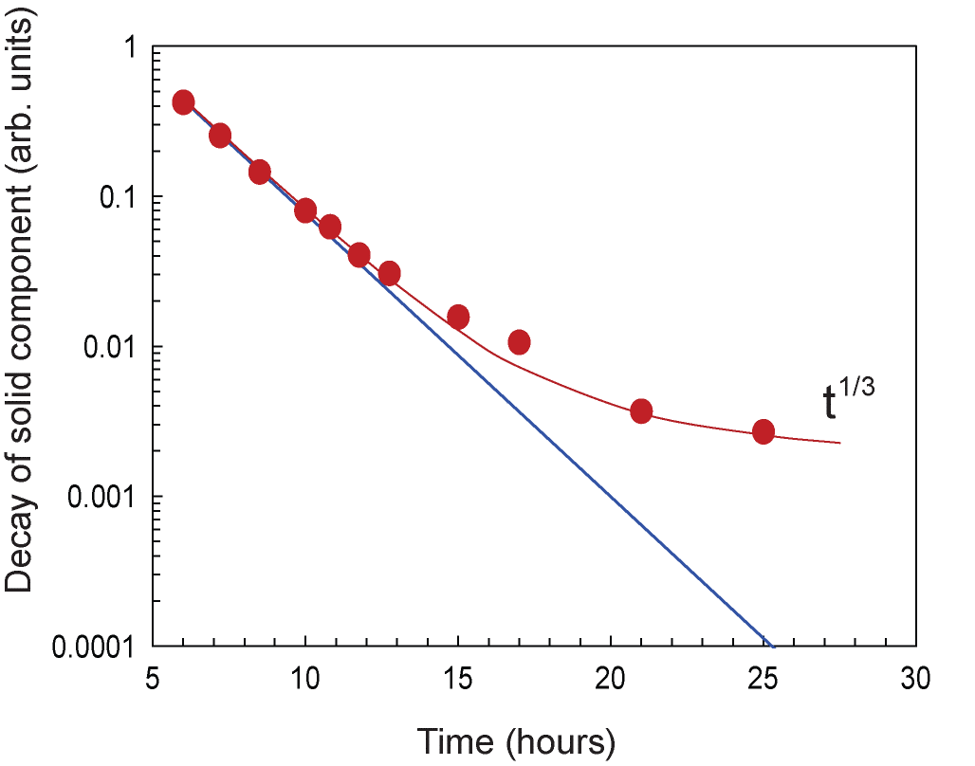
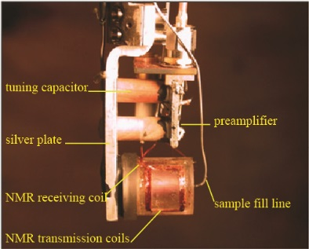
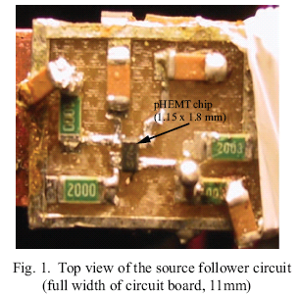
Kinetics of ³He Nanodroplet Growth in Solid Helium Solutions
D. Candela (U. Mass.), B. Cowan (Univ. London),
C. Huan, L. Yin, J. S. Xia (Univ. Florida-NHMFL)
Phase separation in ³He-⁴He mixtures
First order phase transition with a conserved order parameter.
The quantum nature of dynamics
“fast” time scales (~ hours)
cf “months/years” for metal alloys.
Pulsed NMR techniques
observe change in NMR amplitude
with formation of nano-droplets of ³He
First observation of solid mixture to liquid droplets
transition at very low concentrations.
Low temperature electronics
--- enhanced signal/noise
Figure 1. Long time decay of NMR amplitude of
solid component f sample as solid is lost to
degenerate Fermi liquid.
Long time growth scales as t^{1/3}
Determined by flux at surface of droplet
Known as Ostwald ripening
Phys. Rev. B 95,104107 (2017) [editor’s choice]

Slide 19


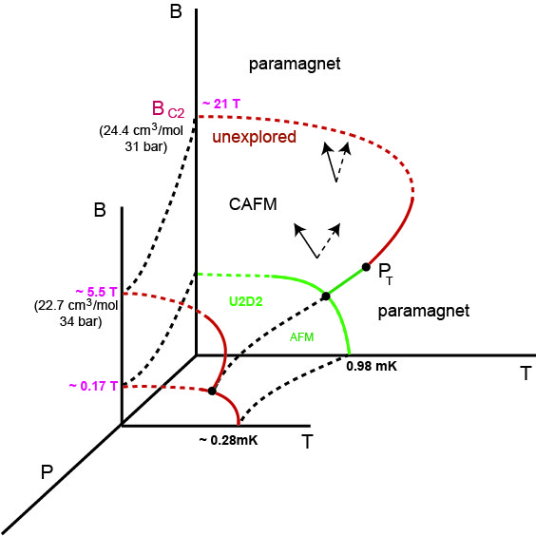
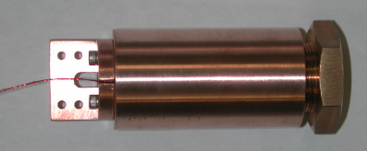
High B/T Priorities & New Directions
Reduce length of queue for magnet time
--- currently approx. 9 months
Increase staff support
--- cell design requires close work
with local staff
Low temperature Instrumentation
----- RF electronics, SQUIDs needed
(some success NMR, T_{N} < 0.5 K)
Open Bay 1 ?
e.g. (i). Very low T, high B phase diagram ³He unexplored
(ii). High B splitting of A transition, p-wave ³He superfluid
Current Development
High pressure at low T
(J. Hamlin, J. S. Xia)

Slide 20
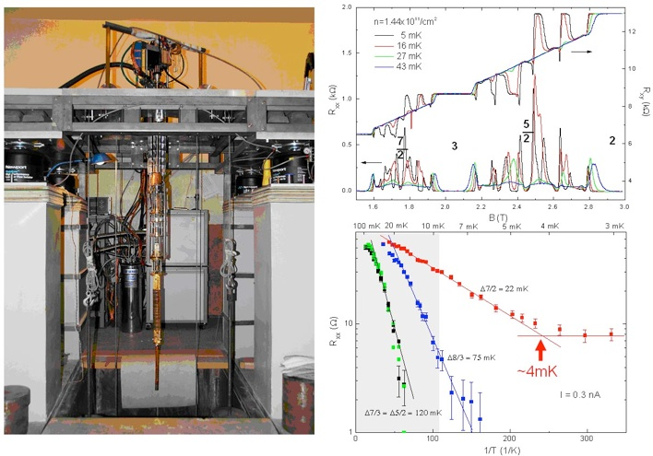
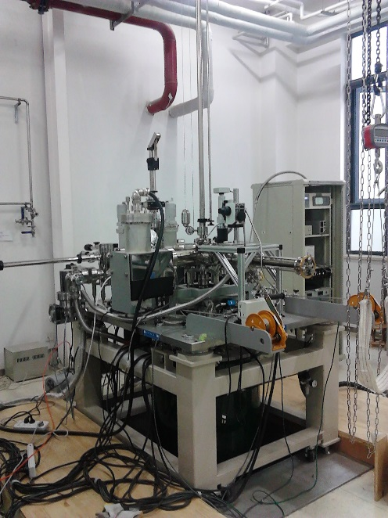
COMPETITION:
High Field/Low Temperature
Research Facilities
Key Laboratory for Extreme Conditions
(Chinese Academy of Science) Li Lu
Nuclear Demagnetization Stage:
0.5 mK in 11T
Electron temperatures
In 2DES
2. International Center for Quantum Materials
(Peking University) Xi Lin (Dan Tsui Laboratory)
Ultrahigh Vacuum, Ultra Low Temperature and High Magnetic Field Scanning Probe Microscope (UNISOKU), 400mK with 9T/2T/2T vector magnets, in situ cleavage/deposition

Slide 21
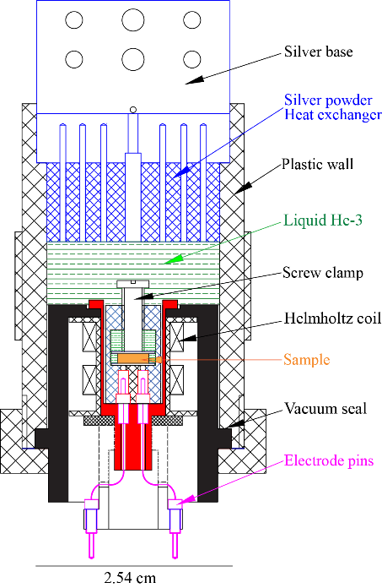
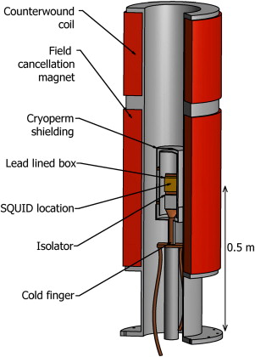
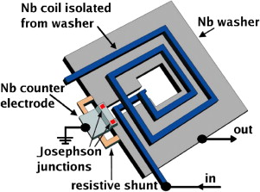
Future: Low temperature Electronics/Devices for High Sensitivity Measurements
Generic cell:
Multiple inserts
(susceptibility, transport,
magneto-electric…)
Meet user needs for high sensitivity measurements
e.g. Electric and magnetic susceptibilities
Magneto-electric effects
Sample immersed in superfluid ³He
Low Temperature electronics (successful for low T NMR but can be used at low f)
SQUID detectors for extreme high sensitivity measurement
capabilities: enhanced resolution on smaller or low
dimensional samples (Y. Lee et al.)
(Use field free space above nuclear refrigerator.)
Example: Schematic of ADMX experiment above large volume 8T magnet with shielding for the SQUID (sensitive to yW levels at 1GHz.
T_{noise} = 50mK
(GHz)
Asztalos et al. (Nucl. Instr. A656,39 (2011))

Slide 22
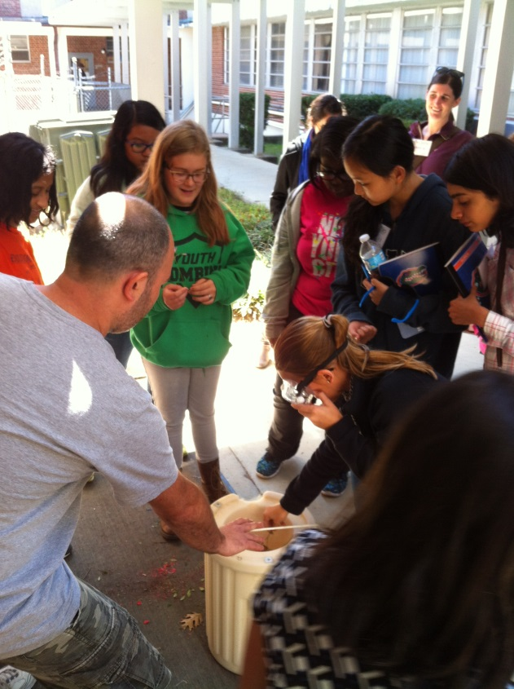


Outreach Activities
Lab tours
2016
Teachers with the Annual Florida Regional Junior Science, Engineering, and Humanities Symposium
WiSE Girlz Spring Break Camp
Uncommon Reads Honors class
Student Science Training Program
2016-2017
REU students
Physical Chemistry course
Classroom visits
High B/T students and staff visit local classrooms 2-3 times per month, offering lessons in how to build an electro-magnet (4-12), the nature of science (4-8), and magnet exploration (K-3). Faculty also lead after-school “Physics is Fun” demonstrations.
Dr. Serafin helps WiSE Grilz Spring Break camp participants experiment with liquid nitrogen after a tour of the Microkelvin Facility. (March 2016)
Dr. Huan gives tour to teachers with FL Regional Junior Science, Engineering, and Humanities Symposium (Feb. 2016)
Prof. Hamlin leads an afterschool group in a Physics is Fun demonstration. (Nov. 2015)
Recent PhDs
Pan Zheng (UF PhD, 2016, Lee)
Yibing Tang (UF PhD, 2016, Sullivan)
Marcus Peprah (UF PhD, 2015, Meisel)
Pedro Quintero (UF PhD, 2015, Meisel)
Chris Aoyama (UF PhD, 2015, Takano )
Elisabeth Knowles (UF PhD, 2013, Meisel)
REU (2017)
Mitchell Peck, Investigation of RCO₃Si₂, RNi₃B₂ (Hamlin)
Dustin Watts, Specific Heat Measurements for Single Crystal LiGaCr₄₈ (Takano)
Lucas Wilkins, Characterization of MEMS devices (Lee)
Demonstrations
Prof. Sullivan gives tour to REU students (June 2015)

Slide 23



Thank You!
Chao Huan (huan@ufl.edu)

Slide 24


Long term Strategic Goal:
B> 30 T at Ultra-low Temperatures
Ba₃Mn₂O₈
Expand Parameter Space
Extend available B at ultra-low temperatures
to 30-32 T, would allow users to conduct
experiments currently not possible elsewhere
Examples of Need:
1. Determine critical behavior at BEC transitions
for quantum magnets
2. High-density high-quality fqHall samples
(test ideas on broken symmetry and topological quantum order)
3. Anisotropic p-wave A transitions in superfluid ³He for B>15 T.
Probes underlying physics of broken symmetry relevant
to HTS
4. High-field phase diagram nuclear spin
ordering in solid ³He
Samulon et al.
(2010)
need LT data
Nijmegen
(2014)
High B ?
Remeijer et al.
(1998)

Slide 25



University of Florida
Plans for Existing Space
in New Physics Building
NOTE: Plans Under Development (TBC)
University of Florida High-Temperature Superconducting Magnet Facility:
A world leading user facility breaking the high field barrier to enable transformative research in areas of:
magnetic resonance,
condensed matter physics, and
materials science

Slide 26

University of Florida Plans
Under Development
Proposing legislative budget request for
(1) magnet acquisitions, installation
(2) Staff + Faculty support
EXISTING SPACE
IN NEW PHYSICS
BUILDING

Slide 27
Competing Quantum Hall Phases:
Second Landau Level of 2D Electron Systems
W. Pan (Sandia Nat Lab.), D. Tsui, K. W. Baldwin, K. W. West, L. N. Pfeiffer (Princeton Univ.)
Science Driver
Quantum Hall Effect in Second Landau Level
Recent progress in fabrication of high-quality low-density samples allows one to probe exotic quantum Hall states such as the n =5/2 and 7/2 states a new regime where the electron-electron interactions are strong.
Two dimensional systems
Proposal section 3.2.c, Fig. 3-2-5
New Low Temperature Results
First observation of anisotropic transport for ν = 7/2 in a high-quality dilute (n=5x10¹⁰ cm⁻² ) 2D electron system.
New behavior attributed to a large Landau level mixing effect that perturbs the pairing stability of composite limit.
upturn in the energy gap for n < 5x10¹⁰ cm⁻²
implies spin unpolarized ground state
Competing quantum Hall phases in the second Landau level in the low-density limit
Ref. W. Pan et al., Phys. Rev. B 89, 241302(R) (2014)
NHMFL High B/T Facility
Bay 2 of the Microkelvin Laboratory

Slide 28
Magnetic Field Induced Polarization in Bose Glass State
Armando Paduan Filho (Sao-Paulo, Brazil), Vivien Zapf (Los Alamos),
Jian-sheng Xia, Liang Yin (Univ. Florida)
Science Driver
Bose Glass State – Introduce disorder to BEC
Quantum organic magnet:
Dichloro-tetrakis-thiourea-nickel , or DTN.
magnon quasiparticles (Ni spins) undergo BEC.
Disorder intro. in controlled manner (Br doping)
Bose-Glass (BG) state
Magneto-electric Effects – orientation of polar
thiourea molecules in spin ordered states
“glassy” nature of the BG state
induced polarization dependent on frequency of excitation.
Unique high sensitivity ultra-low T dielectric cells
to measure polarization of doped DTN (15% Br)
Ref. : R. Yu et al, Nature 489 (7416), 379-384 (2013).
Low temperature phase diagrams for (a) BEC condensed DTN,
(b) Bose glass state in Br-doped (15%) DTN
Quantum magnetization & Frustration
Proposal section 3.2.f (Fig. 3-2-9)
Crystal structure :
Ni spins blue,
Cl separators green
I. strong frequency dependent induced polarization
II. clear indications of the transitions: BG state to BEC phase
NHMFL High B/T Facility
Bay 3 of the Microkelvin Laboratory

Slide 29
Pinning and melting of a quantum Wigner crystal
T. Knighton, Z. Wu, J. Huang (Wayne State Univ.) A. Serafin, J.-S. Xia (NHMFL)
K.W. Baldwin, K.W. West, L.N. Pfeiffer (Princeton Univ.)
Science Driver
Quantum Wigner Crystals
Seek unambiguous demonstration of crystallization to an electron solid state.
For two-dimensional electron systems, the competing kinetic energy is quenched by application of a perpendicular magnetic field. This leads to new reentrant insulating phases (RIP).
Two dimensional systems
Proposal section 3.2.c
Very-Low Temperature Results
Studied high mobility (m = 3.0 × 10⁶cm²/Vs),
for 20nm GaAs/AlGaAs/GaAs square well.
Observe striking threshold behavior T < 30 mK. Holes are pinned within a narrow range of ±5 pA (resistance > 1 GΩ). Just above Tc
the resistance plummets by ~ 3 orders of magnitude. Pinning is also
destroyed by heating consistent with a melting transition.
Temperature dependence is non-activated existence of a pinned WC appears to undergo a second-order transition upon heating,
in agreement with theory.
Quantum Hall effect in GaAs heterostructure showing
(a) RIP phase;
(b) Small signal IV characteristics
NHMFL High B/T Facility
Bay 3 of the Microkelvin Laboratory

Slide 30




Phase Separation of Very Dilute Concentrations of
³He in Solid ⁴He
D. Candela (Univ. Mass.) B. P. Cowan (Royal Holloway)
C. Huan, S. S. Kim, L. Yin, J. S. Xia (UF-NHMFL)
Science Driver
Phase separation in ³He-⁴He mixtures
First order phase transition
with a conserved order parameter.
The quantum nature of dynamics sets “fast”
time scales (~ hours)
cf “months/years” for metal alloys.
Pulsed NMR techniques
Observe sharp drop in NMR amplitude
with formation of nano-droplets of ³He
First observation of solid mixture to liquid droplets
transition at very low concentrations.
blue symbols, this work
red symbols, Ganshin et al.
orange star, Kingsley et al.
green circle, Sasaki et al.
Integrated magnetic resonance
Proposal section 3.3
Huan et al., Proc. Qu Fluids & Solids Symp. 2015
Transition temperatures in excellent agreement with
statistical solution theory for quantum system
$T_{ps}= \frac{0.76}{k_{B}}\frac{\left(1−2x_{3}\right)+A_{3}}{\left[ln\frac{1}{x_{3}}−1\right]}$
Used high sensitivity
low temperature RF amplifier/detector

Slide 31

Reducing the Queue
Goal: reduce queue for access to magnet time to less than 4 months
Open Bay 1 to NHMFL users (2016-20)
  Need additional staff
  --- dedicated Staff Scientist plus Post-Doctoral Scholar
  Equipment upgrade
  --- ³He circulation pumps, Dilution Refrigerator

Slide 32

Metamagnetism and complex low temperature
phase diagram of Ce₃TiSb₅
James J. Hamlin¹, Daniel Jackson², Tracy Stevenson³, Jian-sheng Xia (NHMFL-UF)
1. New User, 2. Graduate student, 3. REU student
Science Driver
User Collab Grant Award
Magnetically ordered Kondo lattice
Ce nearest neighbors form zig-zag chains
One unique Ce site
AFM with a series of metamagnetic transitions for field perpendicular to c-axis
Re-entrant paramagnetism near 1.9 tesla
High B/T: Low T magneto-resistance measurements established the phase diagram 0.030 - 2 K.
Ce zig-zag
Conclusions
Extending phase space
Proposal section 3.2.a
NHMFL High B/T Fast turn-around Annex
Next step: pressure dependence?

Slide 33



Ultra-low Temperature Transport studies of
Low Density Two-dimensional Hole System
Xuan Gao (Case Western Reserve University),
Greg Boebinger, (NHMFL, Florida State University)
A. Serafin, J. S. Xia, Liang Yin (Univ. of Florida)
High B/T User Science
Science Driver
Searching for quantum Wigner solid and its phase transition to liquid state near zero field in a dilute 2D hole GaAs quantum well.
Controversy: What is happening near the boundary of the phase transition? Any intermediate phase?
Ultra low temperature transport experiments in high quality samples
can provide whole new perspective to this long standing puzzle.
Results: observe an isotropic incipient Wigner solid in the liquid state!
Series of magnetoresistivity plots of QW 11J at 4mK. Density p in units of 10¹⁰/cm². The dash line illustrates the evolution/melting of 2D Wigner solid while increasing the density p.
Fig.1. Theoretical proposed phase diagram
Support: NSF/DMR
NHMFL High B/T Facility
Bay 3 of the Microkelvin Laboratory
Nature Submitted

